Slide 1

2017

Slide 2
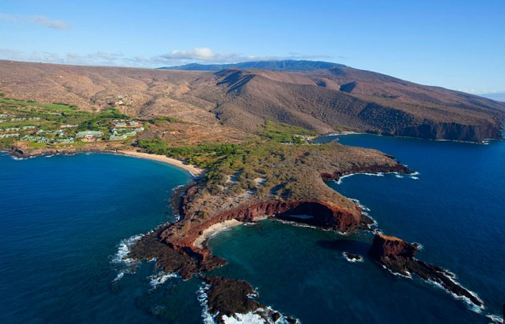
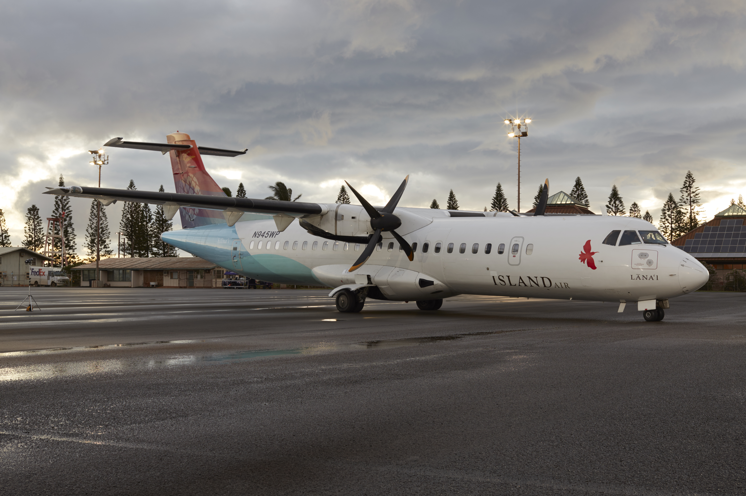
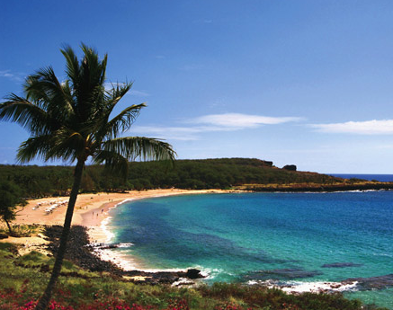
Ownership
In February of 2016 Island Air entered in to a partnership with local investors taking a majority share position and partnering with Mr. Larry Ellison.

Slide 3
Aircraft names
Ola Kūpono, “safety in everything we do”
Na‘au Pono, “genuineness”
Kūlana Pono, “doing the right thing”
Laulima, “accountability”
Poʻokela, “striving for the highest summit”
Hilinaʻi, “trust”
Hoʻomau, “persistence”

Slide 4
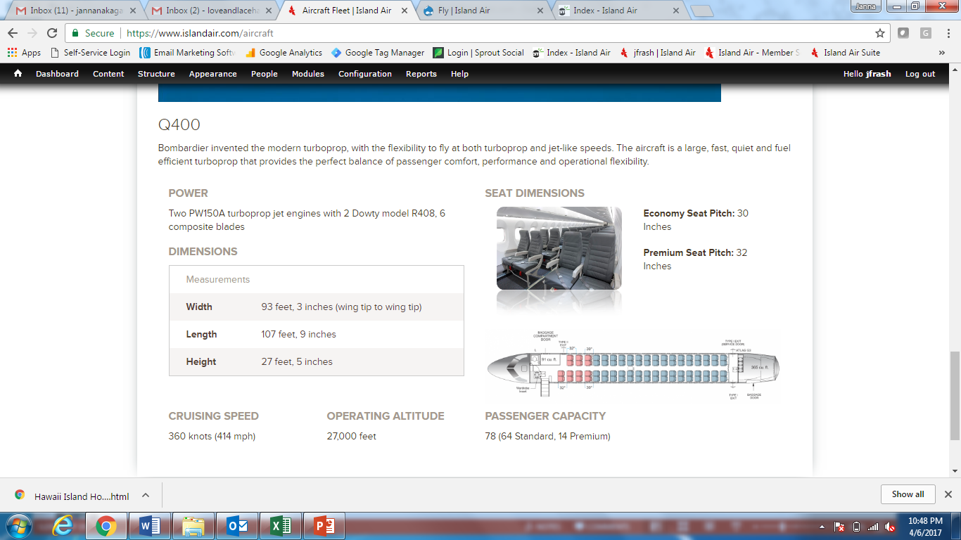
FLEET – BOMBARDIER Q400 TURBOPROP

Slide 5
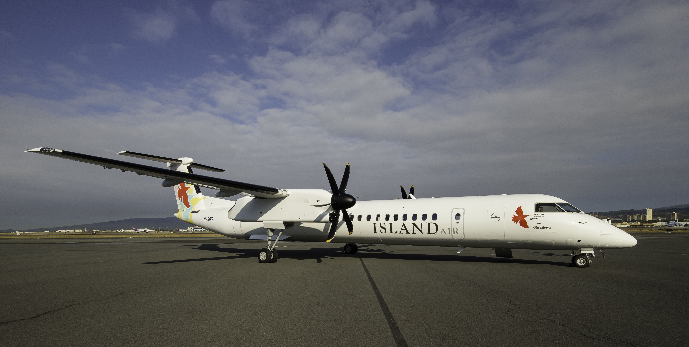

Slide 6
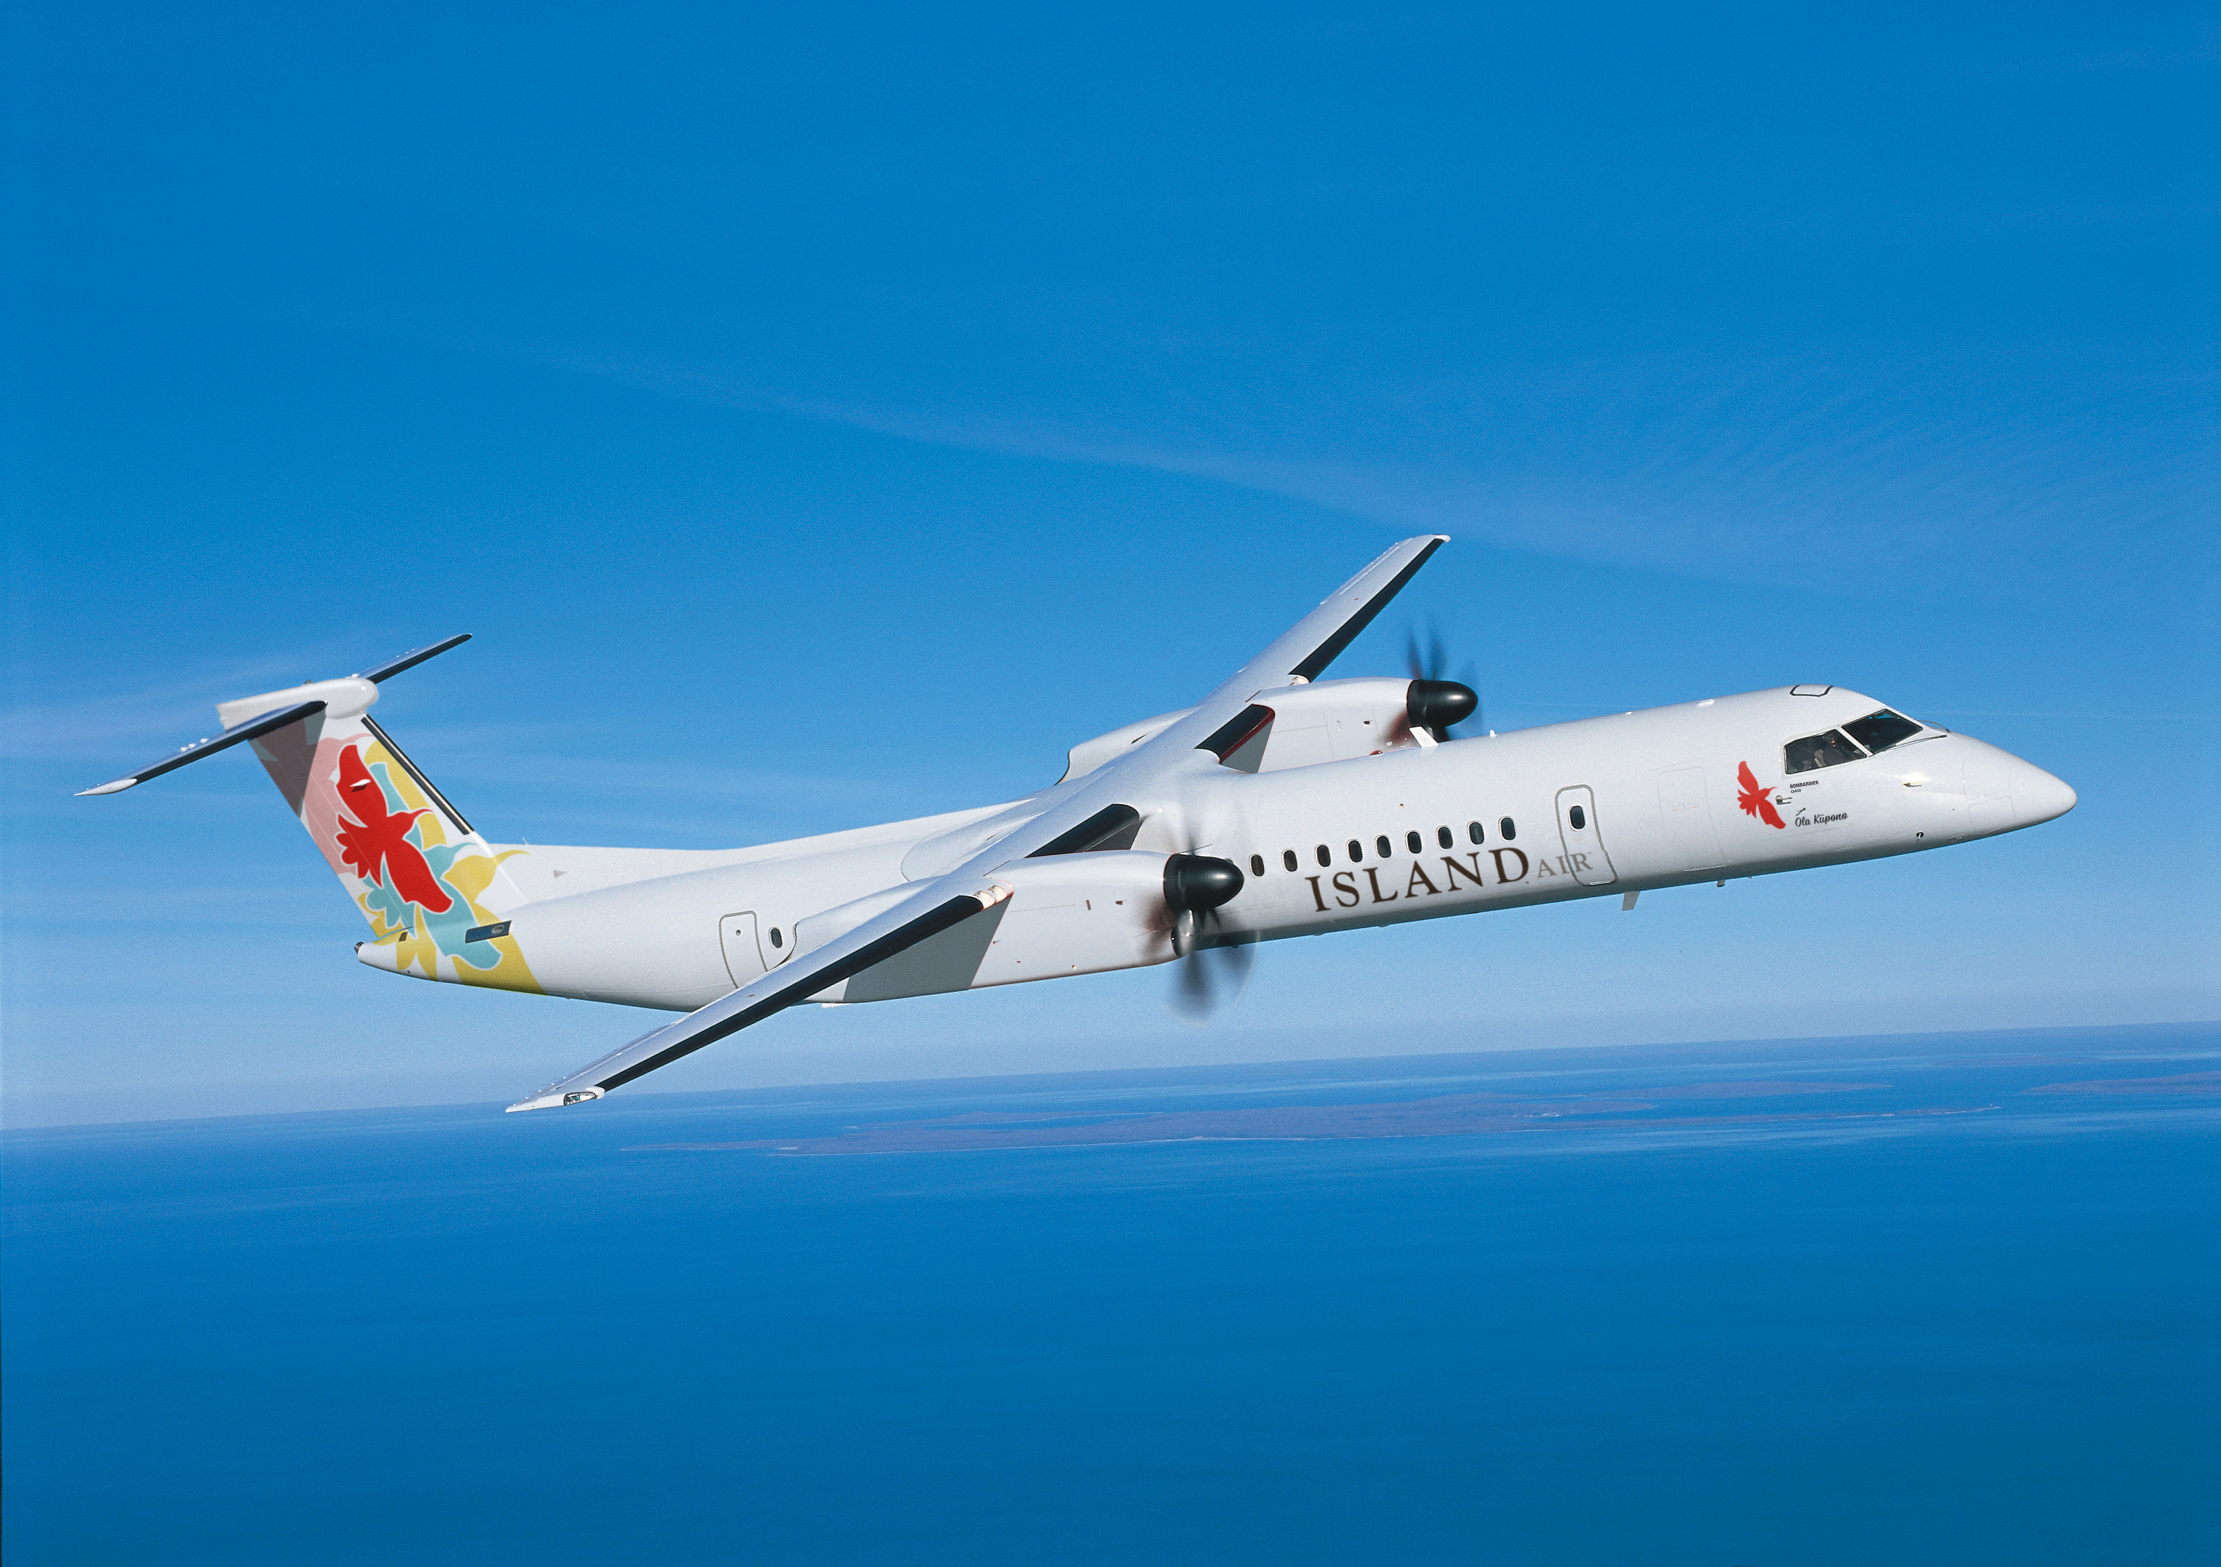
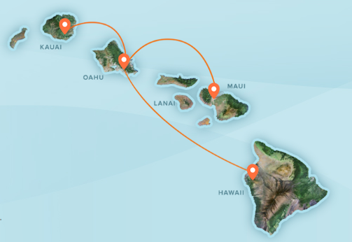
Operations & staff
Island Air provides service between O‘ahu, Maui, Līhu‘e and Hawai‘i Island (Kona and Hilo to tentatively start in Nov 2017)
Fleet of 6 new Bombardier Q400 Turboprop aircraft
Over 440 flights per week
464 Employees 27 in LIH; 31 in KOA)

Slide 9

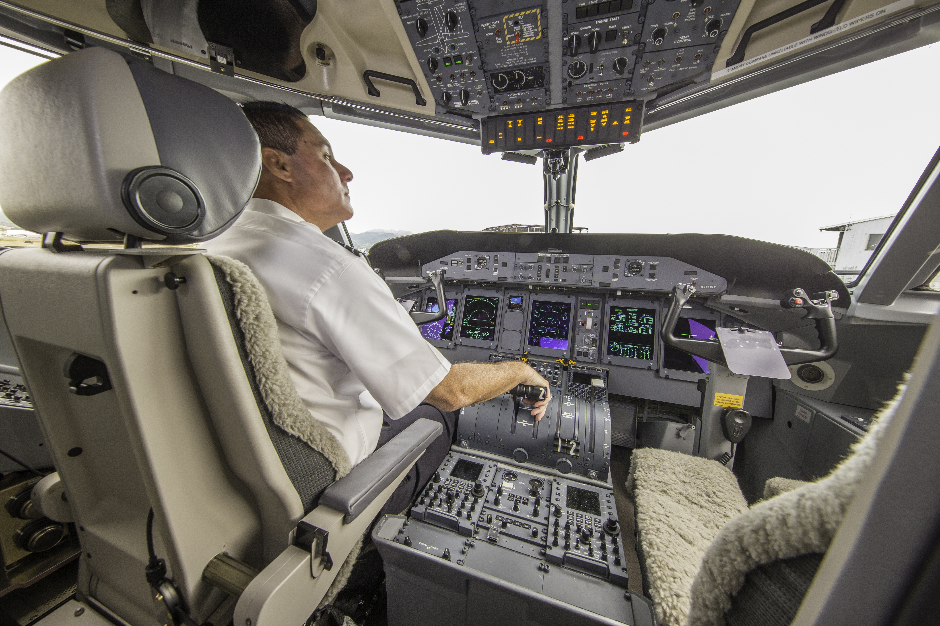
FLIGHT CREWS
Pilots
63 Pilots
FLIGHT ATTENDANTS
54 Flight Attendants

Slide 10
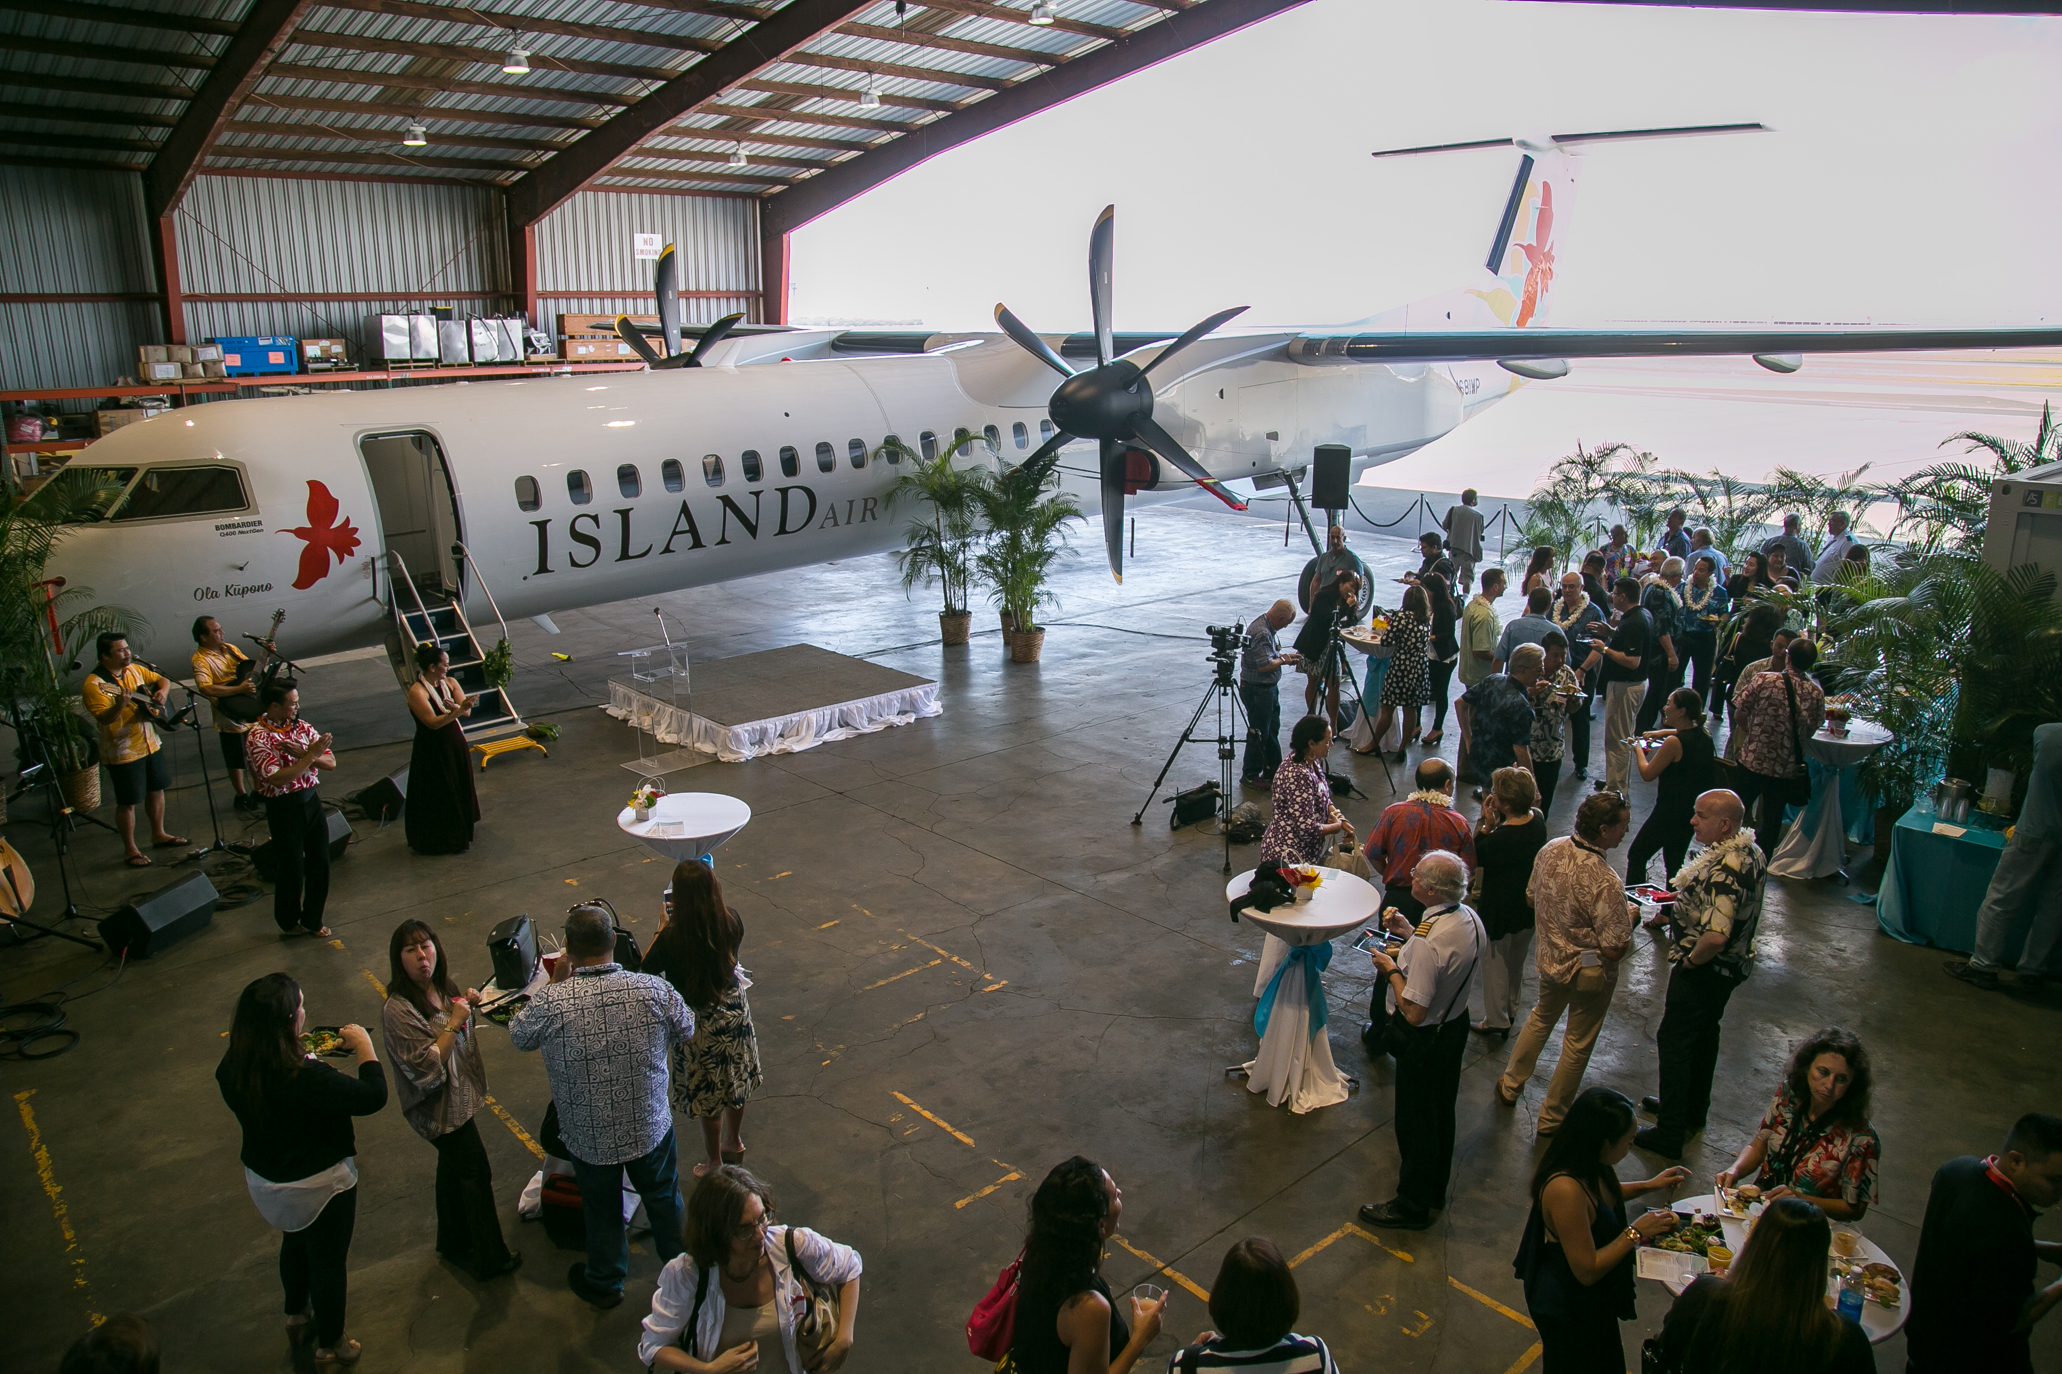
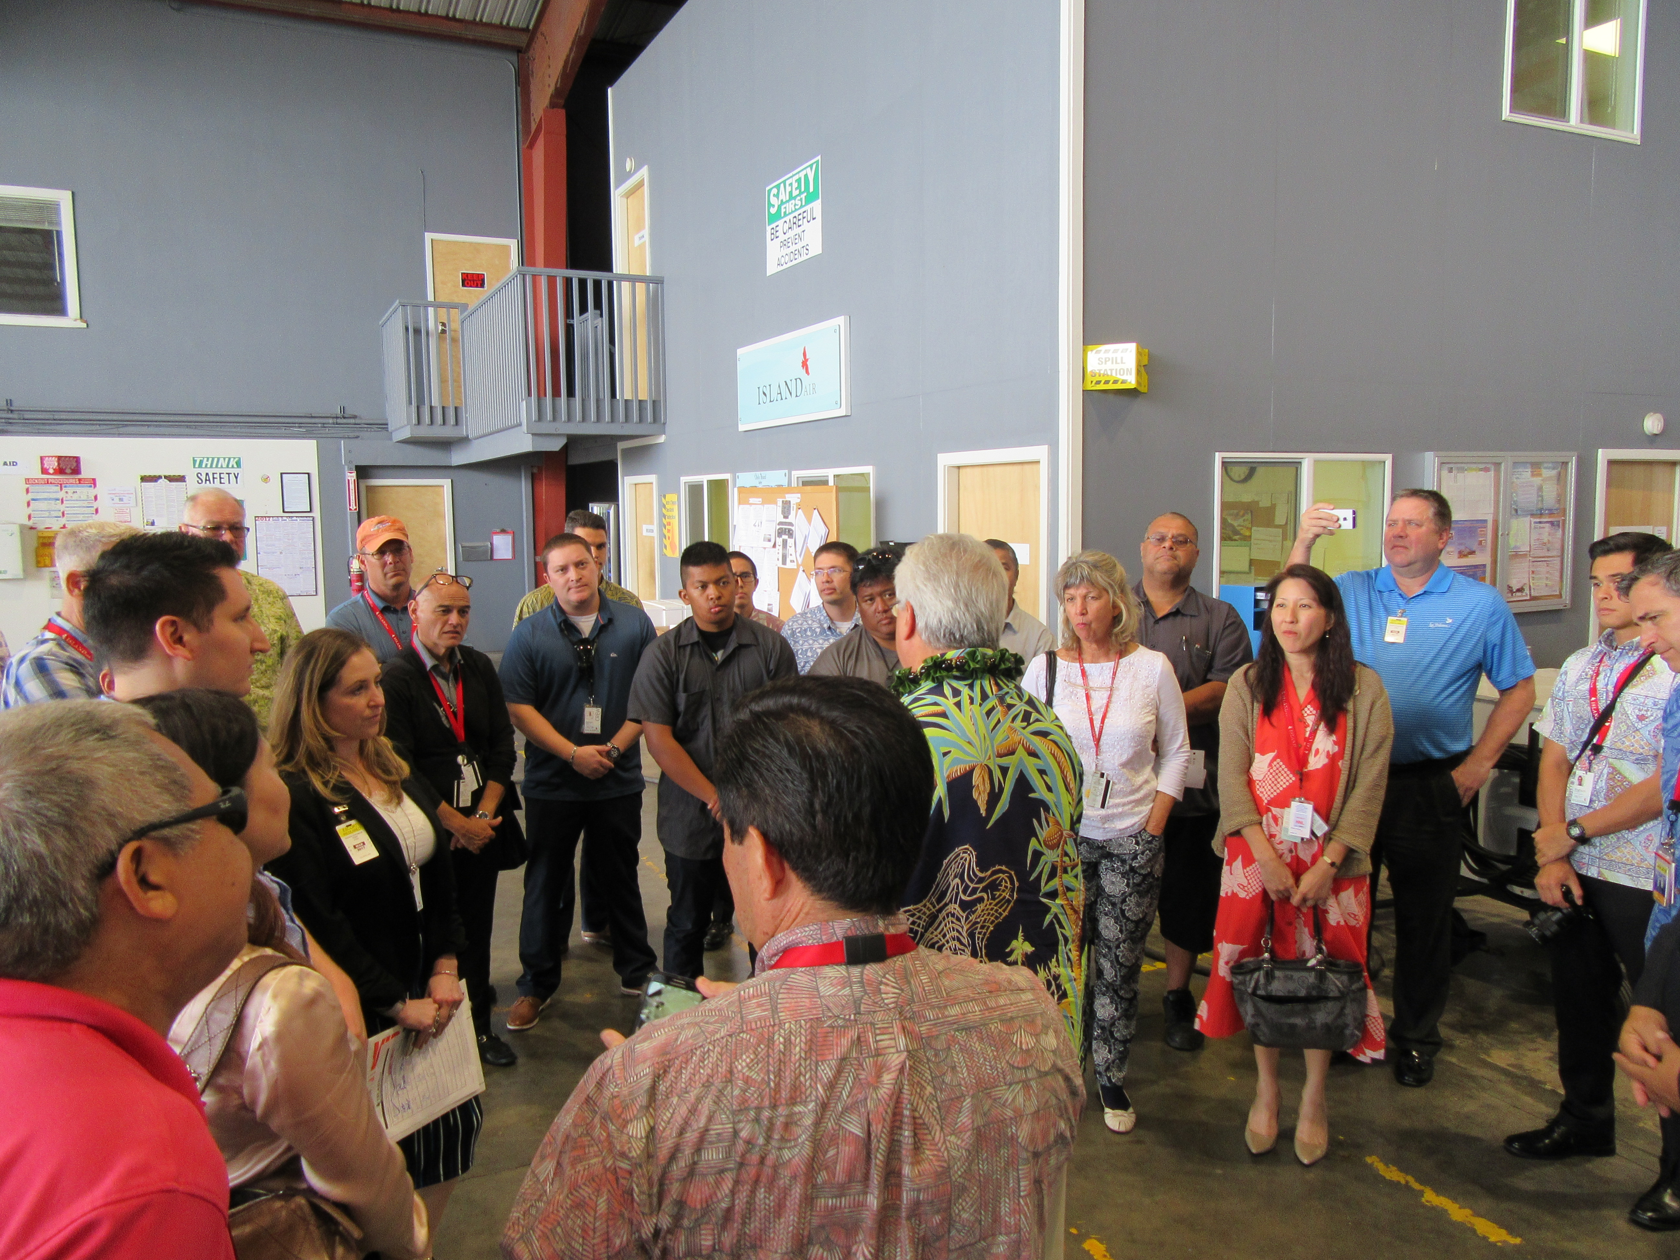
MAINTENANCE HANGAR & OFFICES

Slide 11
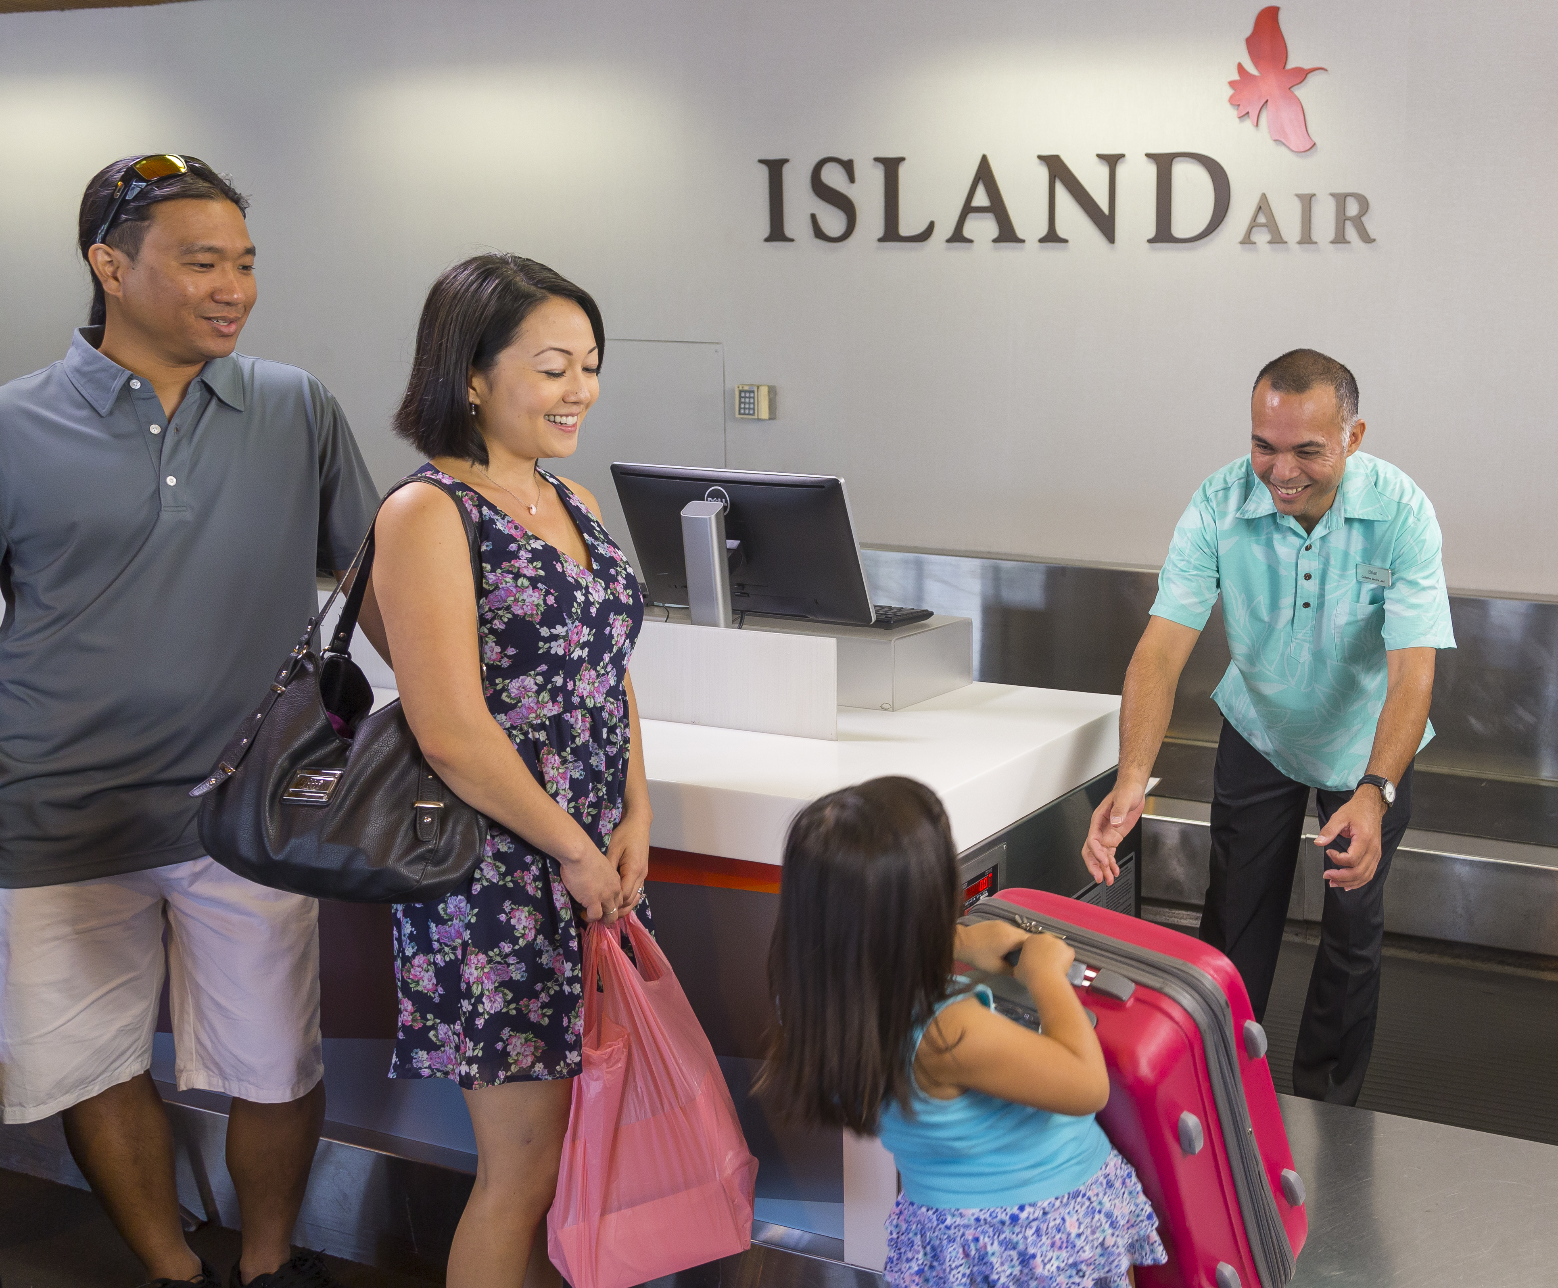
Airport teaM
210 Stations employees (gate agents & ground handling)
4 Stations:
  Honolulu (HNL)
  Kahului (OGG)
  Lihue (LIH)
  Kona (KOA)
  Hilo (ITO) – Nov 2017

Slide 12












codeshare partner & FREQUENT FLYER PROGRAM
interline partners

Slide 13
Flight schedule
As of june 23, over 440 weekly flights

Slide 14
Gate 6 proposal – Hnl airport

Slide 15
Gate 6 proposal – Hnl airport

Slide 16
Gate 6 proposal – Hnl airport

Slide 17
Top accounts
Top 3 ota accounts
Expedia
Priceline
Travelong
Top 3 wholesale accounts
The Mark Travel Corp
Pleasant Holidays LLC
Costco Travel
Tour Series & DMC’s
Globus Tour Series
Trafalgar Tour Series
MC&A
Hawai‘i State Tours
Top 3 Local tour operators
Panda Travel
VIP Tour Corp/Gaja Hawai‘i
Tour Hawai‘i
Japanese Accounts
Hawai‘i HIS Corp
Jalpak International
Chinese & Korean Accounts
Mode Tour Network
Hana Tour USA
Dragon Tours & Travel
Hawai‘i Global Holidays
Australian Accounts
House of Travel (pending)
Flight Centre (pending)

Slide 18
Top corporate accounts
Aloha Care
Kaiser Permanente
Hawai‘i State Teachers Association
Pacific Western
Alutiiq LLC
HGEA
Hawaiian Telcom
State Government Accounts: Dept of Hawaiian Homelands, Dept of Budget & Finance, Dept of Land & Natural Resources, State Parks Division

Slide 19
PROGRAMS
HISGo Partnership
Kupuna & Keiki Fares
TravelPaks
Island Biz, Corporate Program
Islana Miles, Loyalty Program

Slide 20
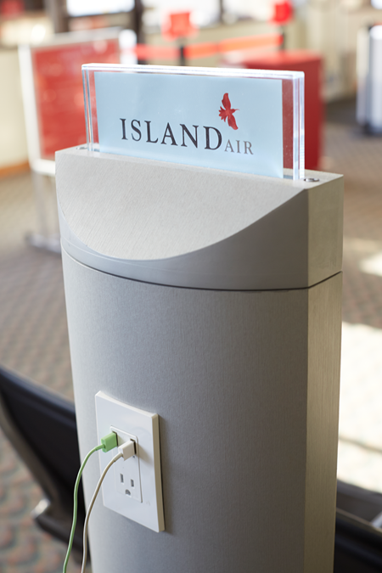

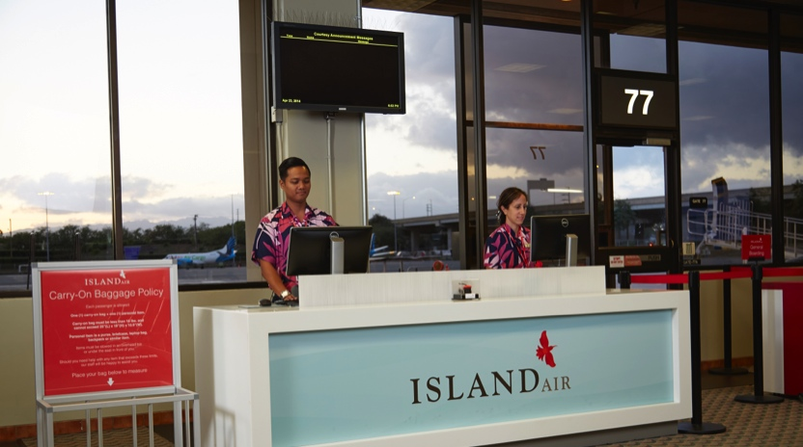
WHY ISLAND AIR ?
  Affordable Inter-Island Fares
  Personalized Service – check-in, gate, in-flight
  Airport Gate Area Amenities Include:
      Free WiFi
      Free Charging Stations
      AM coffee and newspaper service

Slide 21
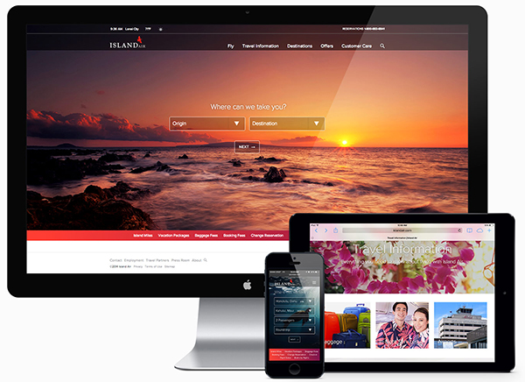
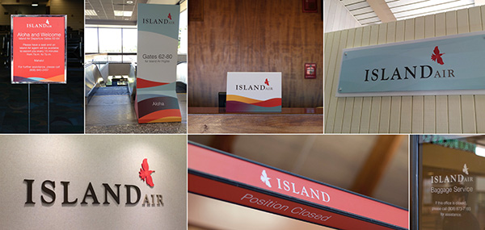
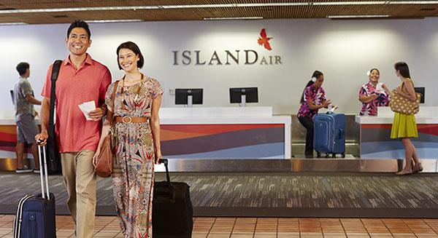

MARKETING & ADVERTISING
Brand

Slide 22
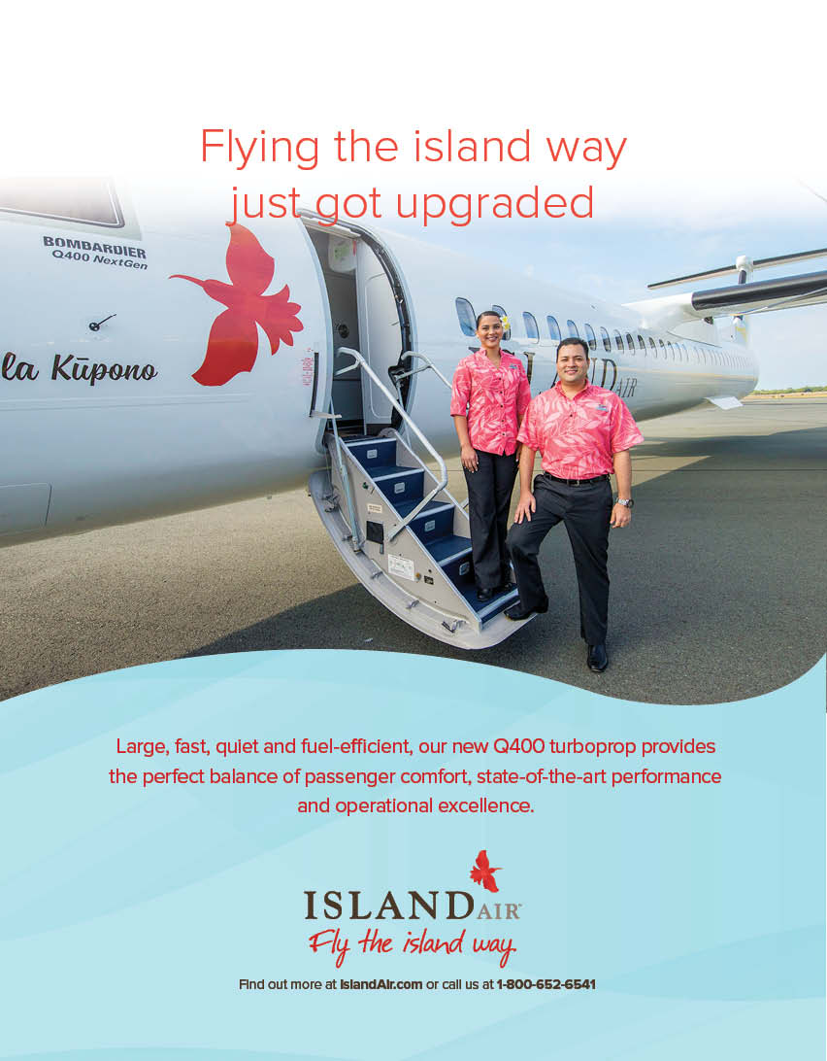




Slide 23
MAHALO

