Slide 1
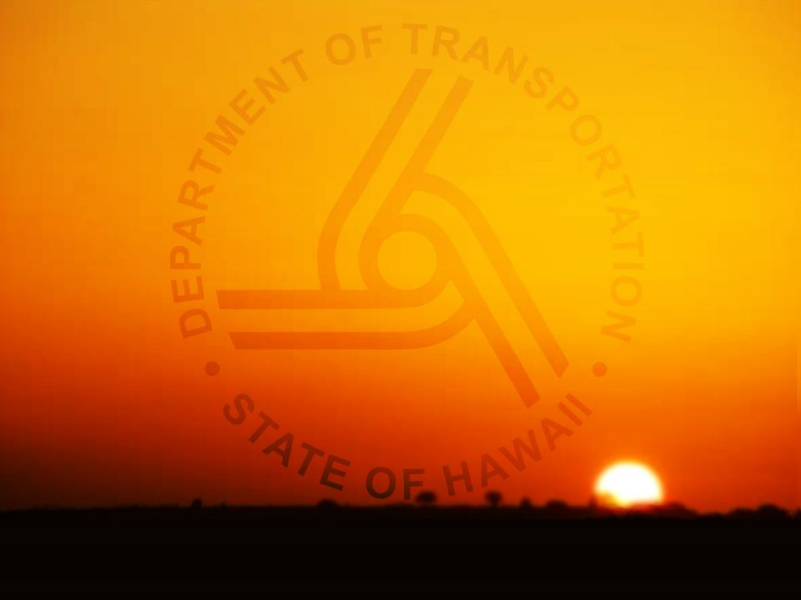
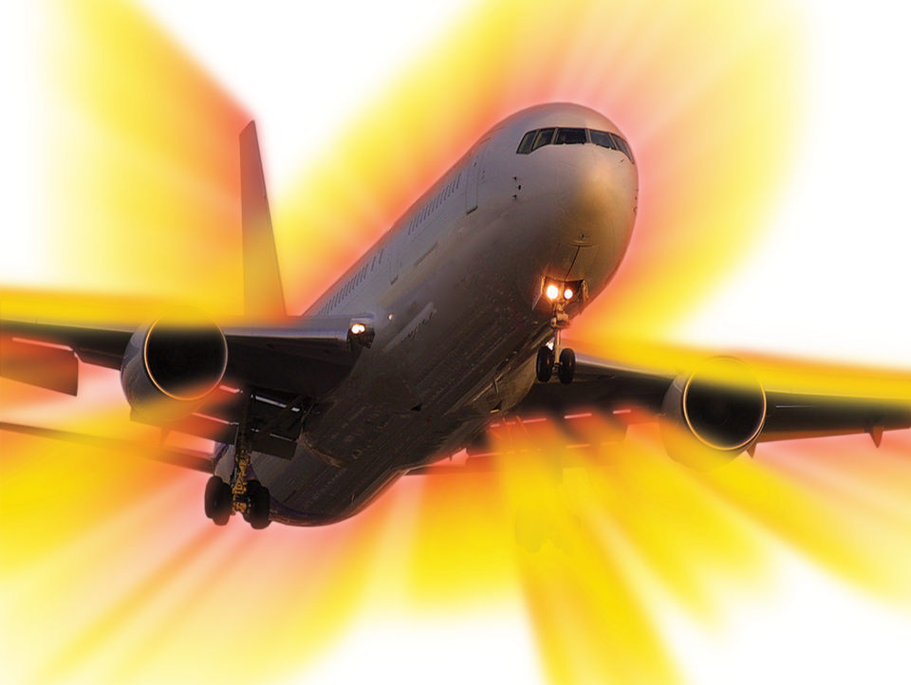
PATA Hawaii
PATA Hawaii
Hawaii’s Airport System Update
August 10, 2017
STATE OF HAWAII DEPARTMENT OF TRANSPORTATION
AIRPORTS Division

Slide 2
Department of Transportation
AIRPORTS DIVISION
AIRPORTS DIVISION
DOTA Continues Major Initiatives in 2016/2017
Enhance financial performance
Strengthen air service development
KOA as 2nd port of entry
Additional overseas service
Improve customer experience
Diamond Head Concourse
Other holdroom and restroom renovation
Automated passport control (APC) kiosks
Wayfinding and Wi-Fi
Capital Improvement Projects
Airport Corporation
Notes:
2

Slide 3
Enhance Financial Performance
The Hawaii Airports System is self-supporting
AIRPORTS DIVISION
The State of Hawaii’s General Fund (tax revenues) does not fund the operation of the Airports System.
Rather, the Airports System generates its own revenues and pays for its own expenses from concession and airline revenues.
The Airports System is a Special/Enterprise Fund similar to a private sector entity.
Primary Sources of Funds | Primary Uses of Funds
Airline revenues: landing fees, terminal rentals, etc. Nonairline revenues: passenger concession fees, parking revenues, etc. Federal grants and Passenger Facility Charge revenues | Operating expenses (personnel, contractual services, utilities, etc.) Debt service payments Capital expenditures (facilities, equipment, etc.)
Notes:
3

Slide 4
Enhance Financial Performance
DOTA’s CPE compares favorably to peers
HNL FY2017 = Est. $9-$10
CPE is estimated to be $12 to $13 after implementation of the capital program, well below CPEs of many peer airports.

Slide 5
Enhance Financial Performance
DOTA’s continuing efforts are recognized by bond rating agencies and enhanced revenues
AIRPORTS DIVISION
Airport Bond rating maintained per July 2017 review
Rental Car Bonds assigned the highest ratings in the nation our HNL and OGG facilities. Savings of $24.8 million due to the positive rating.
Higher nonairline revenues due to lease extension, facility development, and contract negotiations, including duty free, retail, food and beverage, advertising and Wi-Fi, totaling more than $100 million in the next 5 years
Positive Outlook
A to A+
A2 to A1
Notes:
5

Slide 6
Strengthen Air Service Development

Slide 7
Strengthen Air Service Development
DOTA expects enplaned passengers to exceed 2007 peak this year
AIRPORTS DIVISION
Notes:
7

Slide 8
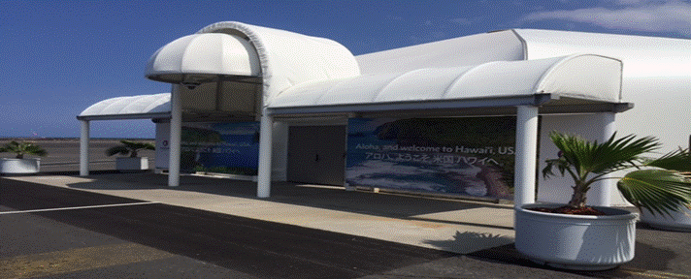
Strengthen Air Service Development
Reopening KOA FIS has major implications to the economy on the Big Island
AIRPORTS DIVISION
Both Hawaiian Airlines and Japan Airlines will operate non-stop international flights to KOA, adding an estimated $150M in visitor spending to the Big Island economy and $20M in tax revenues annually.
The KOA FIS serves as the 2nd port of entry, in case our HNL facility is not available due to an unforeseen event.
A permanent facility is being planned for completion within 4 years
Notes:
8

Slide 9
Strengthen Air Service Development
New carriers and routes imply traffic returning to 2000 level
AIRPORTS DIVISION
AirAsia X started service to Hawaii in June 2017
United Airlines recently announced a major expansion of service to Hawaii
Daily, year-around flights from Denver to KOA/LIH/OGG
Daily, year-around flights from Chicago to OGG
One more daily flight from Los Angeles to KOA/LIH/OGG
One more daily flight from San Francisco to KOA/LIH
Two more daily flights from San Francisco to OGG
This expansion plan would make United Airlines the largest airline flying to Hawaii with an estimated 400,000 added passengers
ANA announced plan to upgauge aircraft to A380 in March 2019
Other major airlines may consider Hawaii for competition purposes
Notes:
9

Slide 10
Improve Customer Service

Slide 11
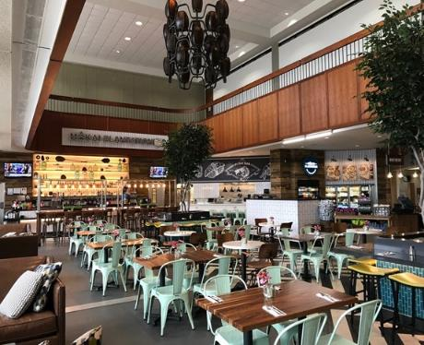
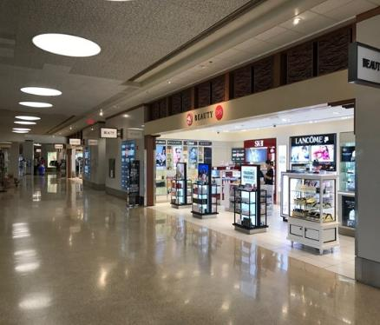
Improve Customer Service
DOTA completed EWA concourse improvement in June 2017
AIRPORTS DIVISION
Diamond Head Concourse improvement has commenced and will mirror the Ewa Concourse
More than $50 million has been programmed for OGG holdrooms, and another $27 million planned for LIH holdrooms
KOA is going through a major terminal modernization program started in 2017
Notes:
11

Slide 12
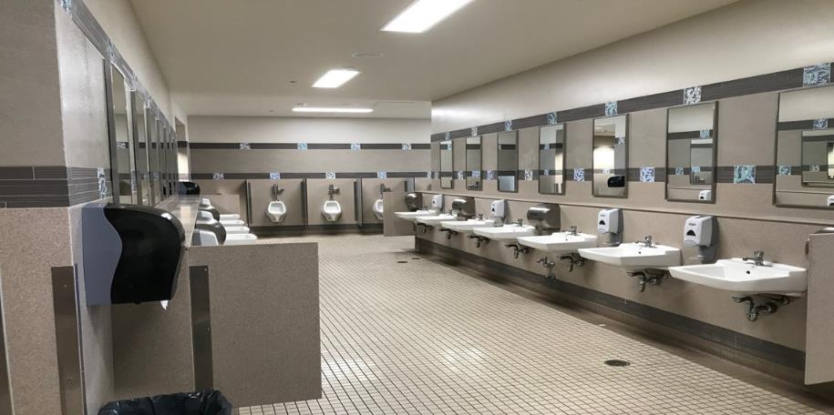
Improve Customer Service
DOTA is keenly aware of the needs to renovate restrooms
AIRPORTS DIVISION
Restrooms at Ewa concourse and OGG have been upgraded
DOTA has received appropriations to renovate other restrooms statewide
Notes:
12

Slide 13
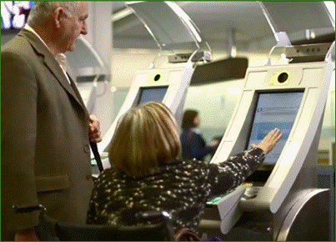
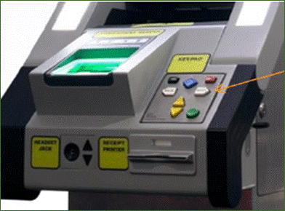
Improve Customer Service
DOTA has been focusing on improving customer service in recent years
AIRPORTS DIVISION
The implementation of 32 APC kiosks at HNL and 10 at KOA is a major success
Additional kiosks are being added to HNL
DOTA is implementing an A380 gate project, and evaluating options to provide better customer service for international arrivals
Notes:
13

Slide 14
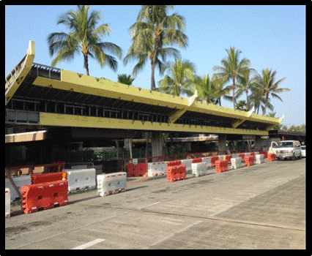
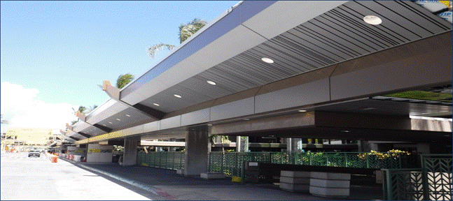
Improve Customer Service
The ongoing metal roof project provides a good first impression
On-going
Public Benefit: Replaces corroded-leaking roofs. Increases height clearances for tour buses to park nearer to curb, protecting passengers during inclement weather.
Start: Jan 2015
End: Sep 2017
After
Notes:
14

Slide 15
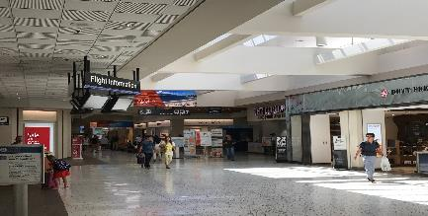
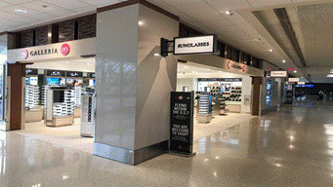
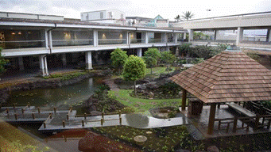
Improve Customer Service
The Public-Private Partnership project provides a fresh look of Central Concourse
AIRPORTS DIVISION
The duty free operator committed more than $70 million of capital projects at no cost to the DOTA, expected to complete in next month
Notes:
15

Slide 16
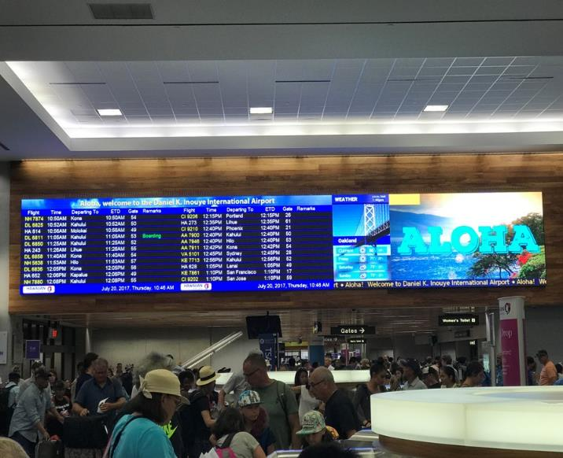
Flight Information Display (FIDS) Replacement
Honolulu International Airport
Public Benefit: Large, easy to read, state of the art Flight Information Display boards for Lobbies and 4, 6, 7 and 8 (2 and 3 completed)
Start: March 2017
End: Feb 2018
Notes:
16

Slide 17
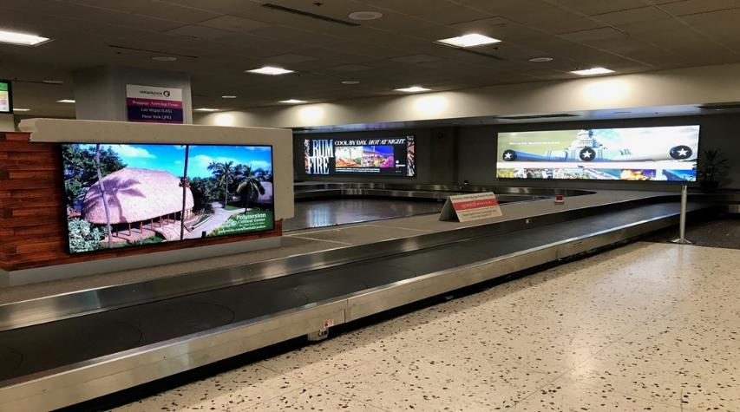
Improve Customer Service
DOTA has selected advertising contractors for HNL and other neighbor island airports
AIRPORTS DIVISION
Both concessionaires have started renovating advertising equipment, which also improves wayfinding throughout the terminal
Notes:
17

Slide 18
Implement Major Capital Projects

Slide 19
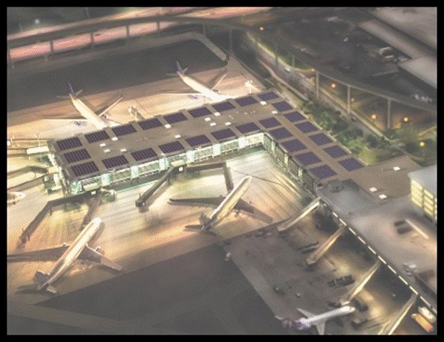
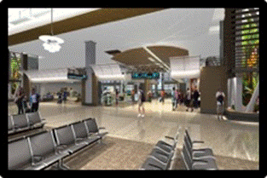
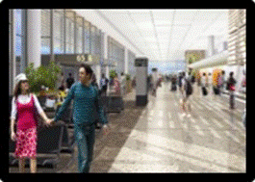
Implementing Major Capital Projects
Three major projects are Mauka Concourse, and HNL and OGG rental car facilities
Public Benefit: Increases gate capacity adding a combination of 6 wide body or 11 narrow body aircrafts.
Construction:
Start: 2017
End (Est): 2020
Notes:
19

Slide 20
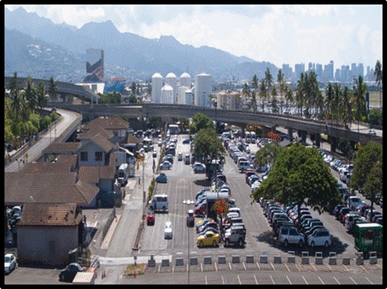
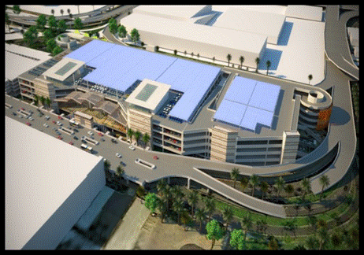
Implementing Major Capital Projects
HNL ConRAC is 10% complete
Before
Public Benefit: Consolidates most of the rental car companies into one facility, including common shuttle buses, carwash, fueling, quick turn-around.
Construction:
Start: November 2016
End (est): Jul 2020
After
Notes:
20

Slide 21
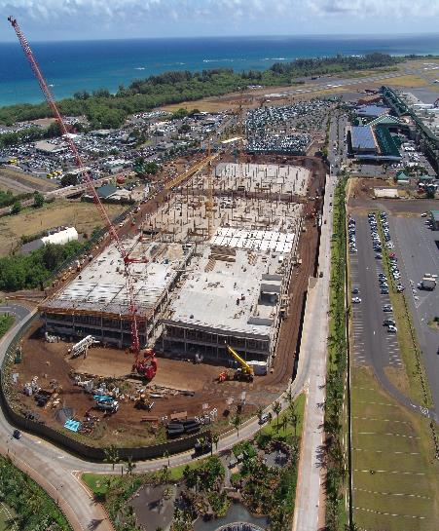
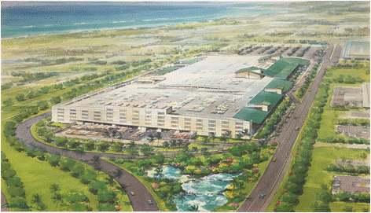
Implementing Major Capital Projects
OGG ConRAC is 30% complete
Public Benefit: Consolidates most of the rental car companies into one facility, including common shuttle buses, carwash, fueling, quick turn-around.
Construction:
Start: July 2016
End (est): October 2018
Notes:
21

Slide 22
Implementing Major Capital Projects
OGG ConRAC is 30% complete
Video deleted
Notes:
22

Slide 23
Department of Transportation
AIRPORTS DIVISION
AIRPORTS DIVISION
AIRPORT CORPORATION
Background
Legislative Bills Introduced Twice - 2016 and 2017 and deferred
Future
Resurrect bill from community leaders and organizations
Reasons
Legislative (open 4 months; must wait for 1 year for new request (A380)) & Procurement Process (low bid vs best value; bid protests); E.g.: Act 46 Central and Ewa Concourse; Airlines wanting to invest; build first and be reimbursed (flow thru rates and charges either way)
Expedite Capital Improvement Projects to promote operational efficiency for airlines and the improved service to the travelling public.
Timely implementation of improvement projects to maintain competition with other US and International Airports
Notes:
23

Slide 24
Mahalo!
STATE OF HAWAII DEPARTMENT OF TRANSPORTATION
AIRPORTS DIVISION

