Slide 1

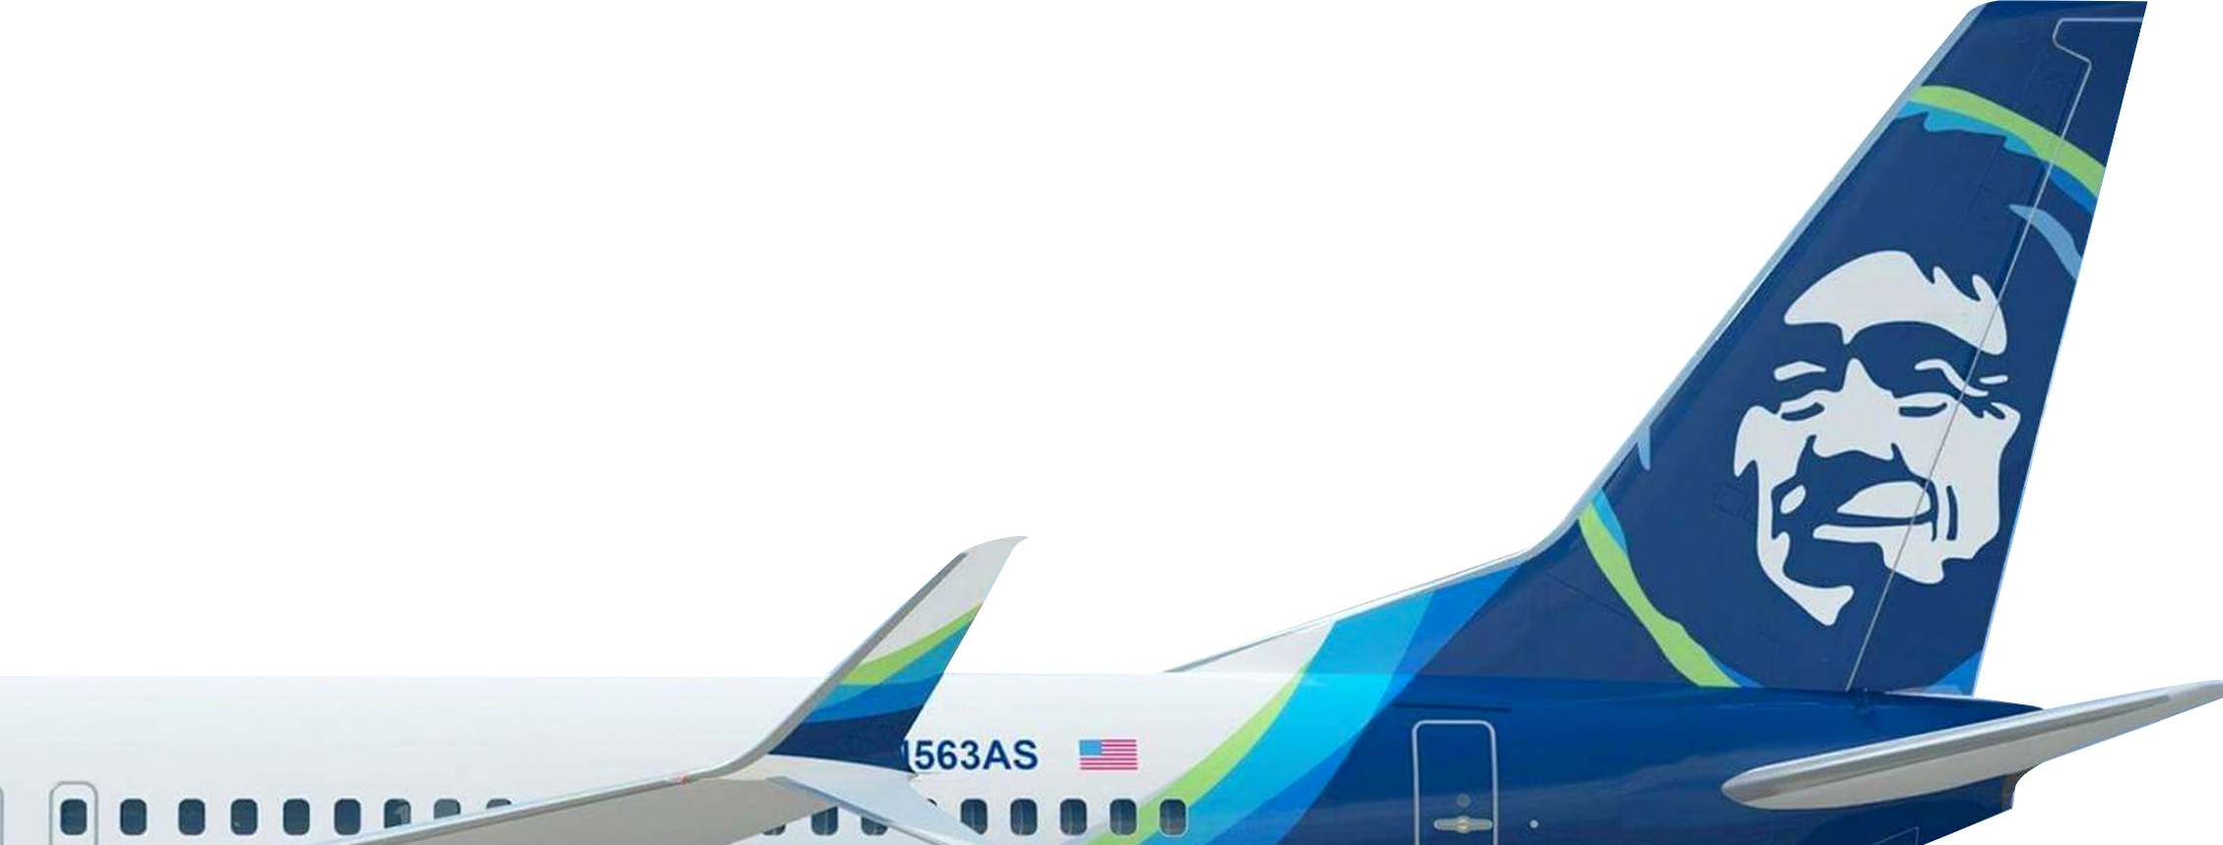
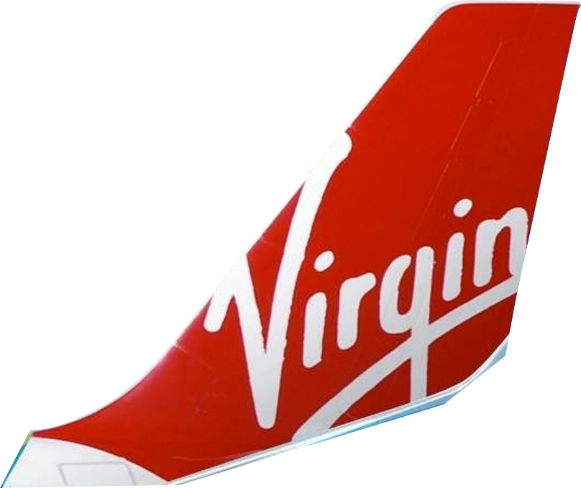
More flights.
More rewards.
More to love.
Notes:
As of X date, we closed the acquisition of Virgin America.
There’s strength in numbers. That means together, our flight options, award power, and incredible service puts us on a whole new level to serve your business.
"Different works" is about recognizing that while Alaska Airlines and Virgin America may seem different on the surface, fundamentally we are similar. Both airlines have always been about doing things a bit differently to offer something better for travelers. Alaska and Virgin America have built outstanding reputations for low fares, on-time performance, innovative products and experiences and award-winning customer service. Together, we equal more than the sum of our parts. Now with a bigger network, more flights and better rewards, we’re looking forward to showing all travelers how different works.

Slide 2


Slide 3
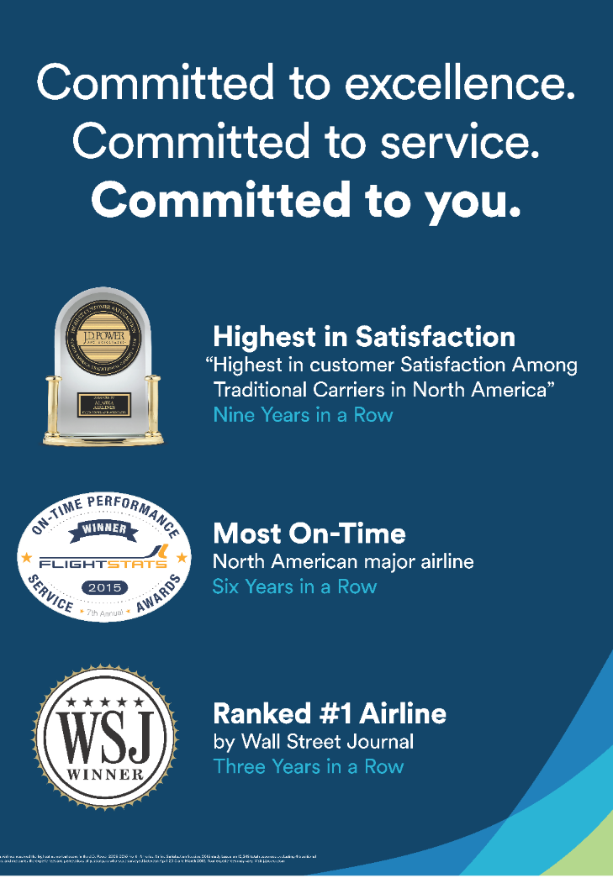
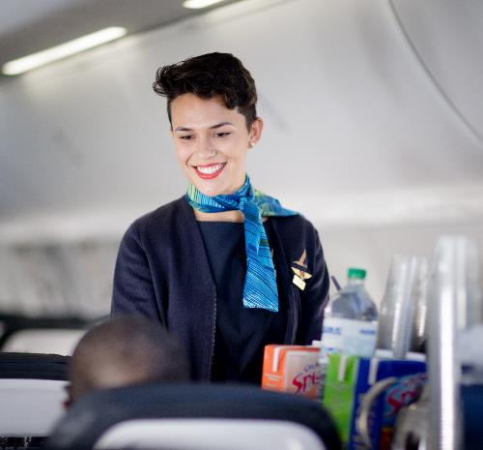
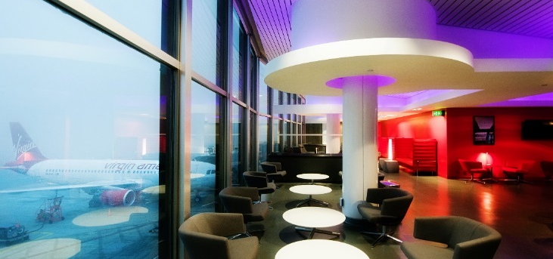
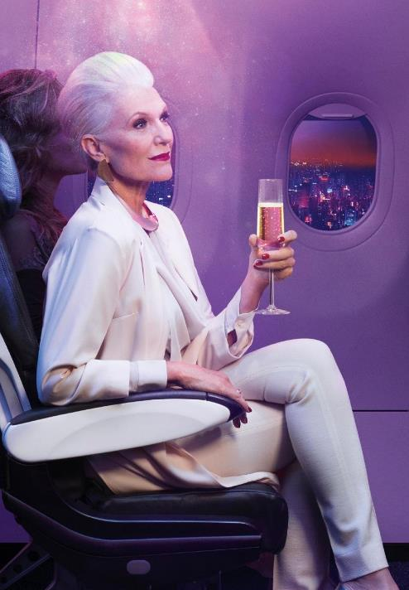
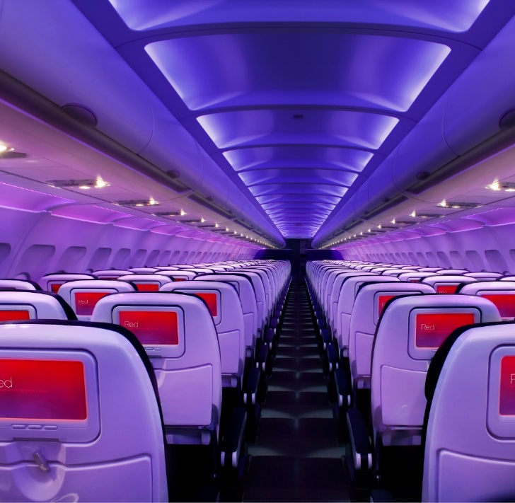
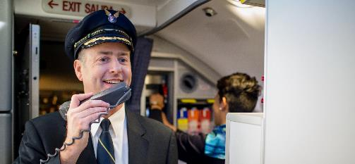


Both brands have strong attributes
Service-oriented
Authentic
Professional
Feel-good
Hip
Bold & modern

Slide 4
Now the 5th largest airline in the U.S.
Print Version
40 million
Annual guests
32 million
8 million
223
286
63
Aircraft
Daily departures
990
1,187
197
Destinations
116
118
22 overlapping destinations
24
Employees
18,400
3,200
21,600
Annual revenue
$5.8 billion
$1.6 billion
$7.4 billion
Notes:
And the 5th largest US carrier.

Slide 5
More
flights.

Slide 6
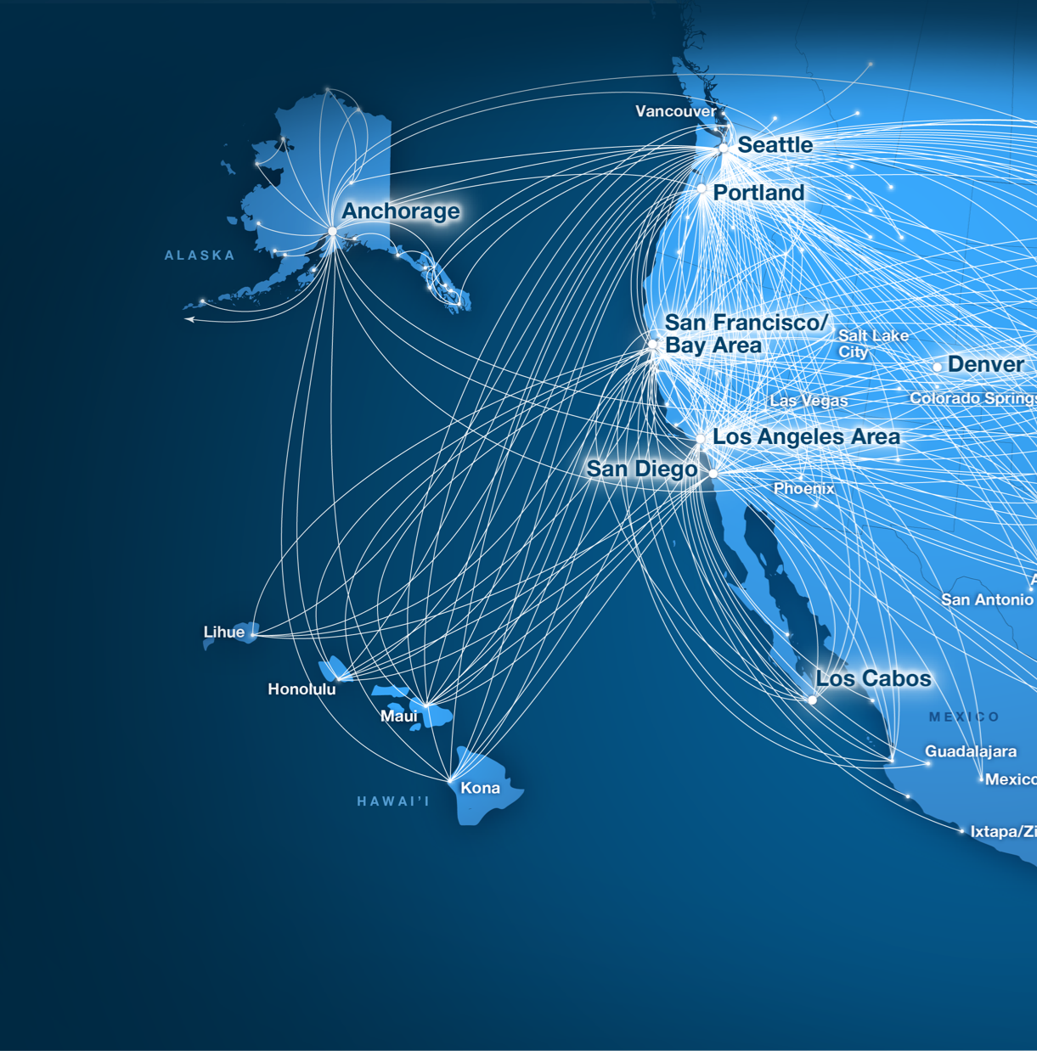
#MOSTWESTCOAST
Alaska operates the most non-stop flights from Hawaiʻi to the most destinations on the West Coast, with an average of 26 daily flights.
Fly nonstop to the West Coast from Kauaʻi, Oʻahu, Maui and Hawaiʻi Island.
Based on full-year schedule, compared to other airlines.
Some flights may be operated by Virgin America.

Slide 7
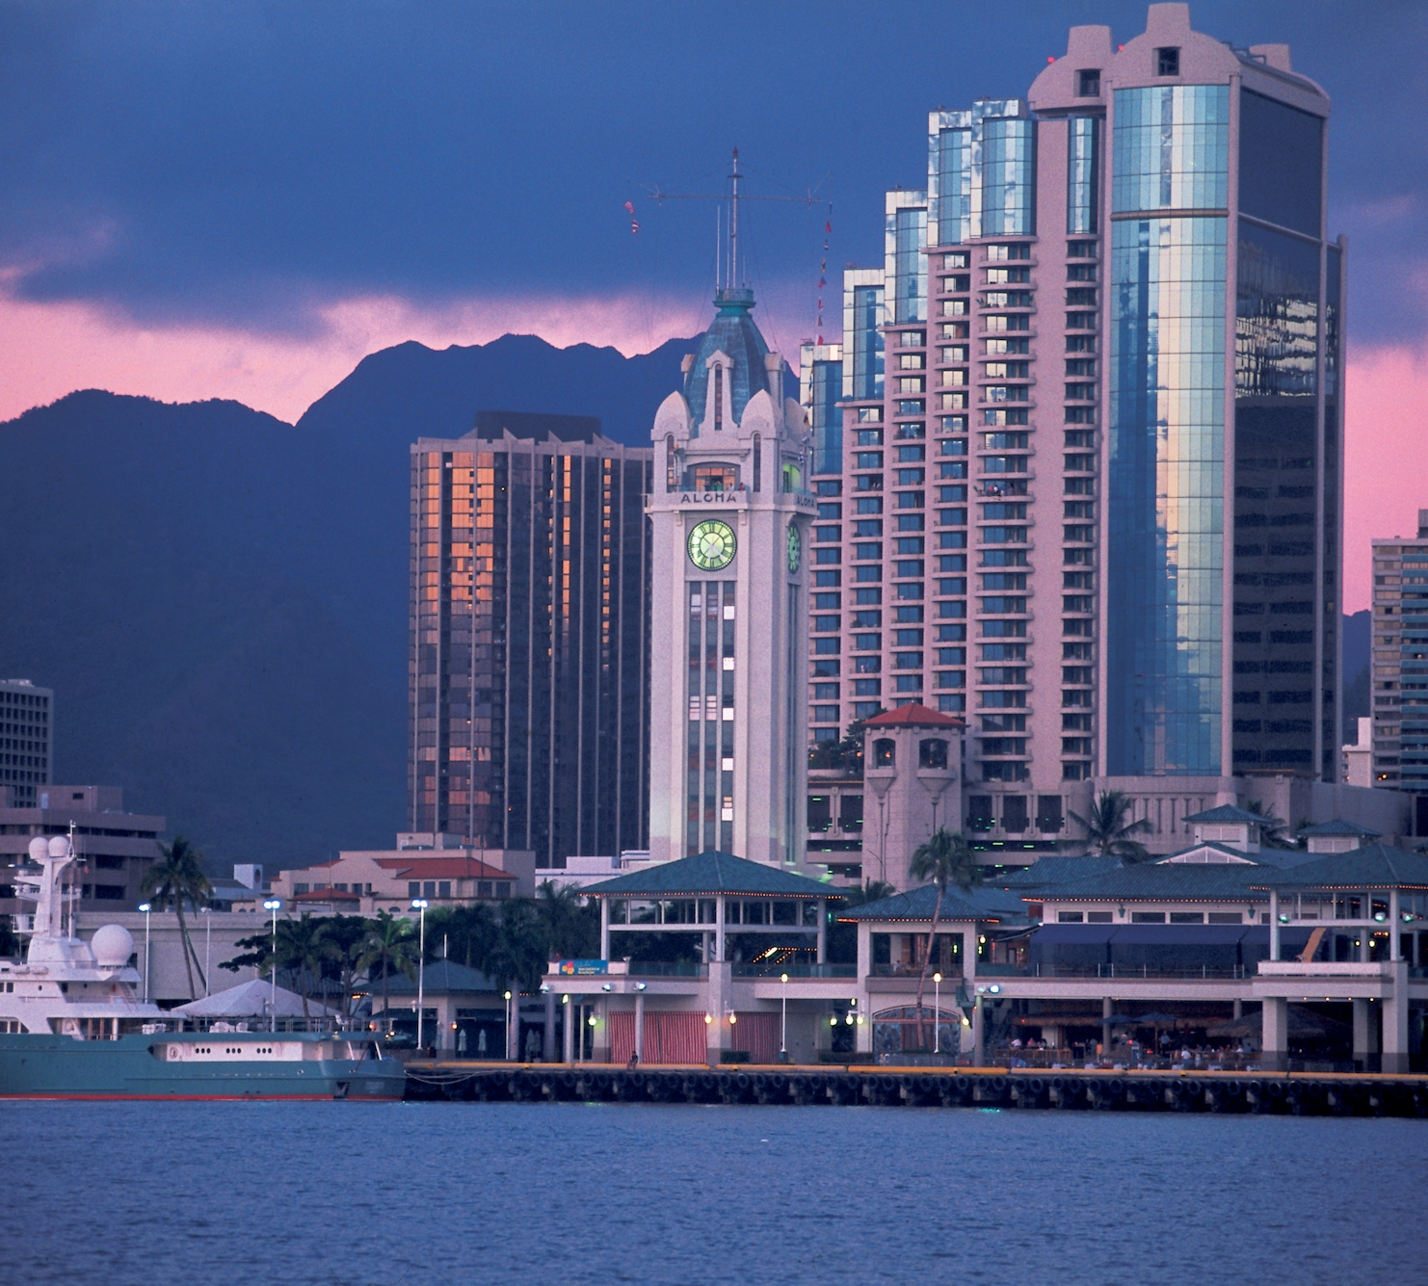
Los Angeles
1
Seattle
2
San Francisco
3
Oakland
4
Hawaiʻi
Las Vegas
5
San Diego
6
Non-stop service to
7 of the top 10
markets from Hawaiʻi
San Jose
7
Portland
8
Phoenix
9
Denver
10

Slide 8
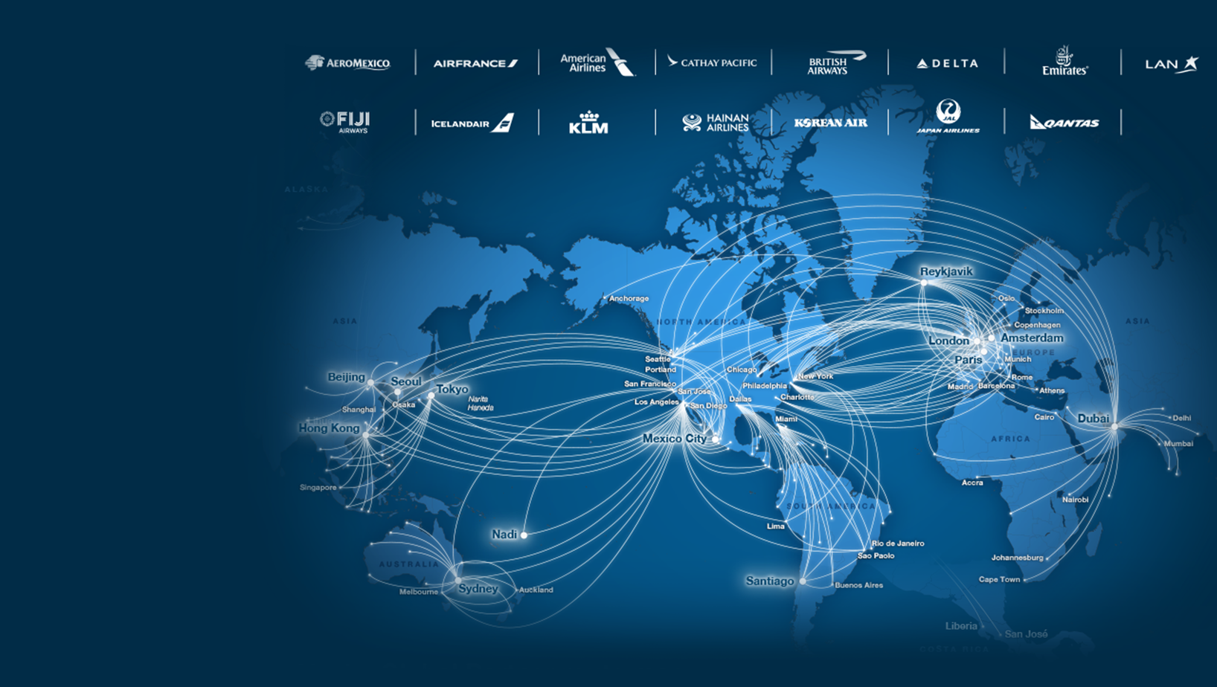


When your travels
take you abroad
Fly to over 900 destinations worldwide with our global partners.
Notes:
When business takes you abroad you can fly to over 800 international destinations with our expansive global partner network or give your employees/travelers the ability to book award travel on our partner network, to travel to exciting new places in the U.S. and internationally.

Slide 9
Low
fares.

Slide 10




LIH
HNL
Alaska keeps
fares lower to the West Coast
OGG
Average fare ($)
Stage-length adjusted
KOA
Source: US DOT YE Q1 ‘17 Hawaiʻi Origin and CA/OR/WA Destination

Slide 11
More
rewards.

Slide 12


#MOSTWESTCOAST
Fly a mile.
Earn a mile.
Alaska operates the most nonstop flights, to the most destinations, from the West Coast.
Over 1200 daily flights to 119 destinations in the United States, Canada, Mexico, Costa Rica and Cuba.
Alaska is the only major US airline to offer miles for distance traveled, not just for dollars spent.
Award travel starts at 5,000 miles.
5,000
Notes:
Alaska’s MP program is the only major domestic US airline program that still awards travelers based on the miles flown very the dollars spent. This more favorably impacts travelers booking in competitive fare levels. As you, the buyer want to encourage the lowest logical fare, this can help keep compliance because guests are still awarded miles for the distance, even on the lowest priced fares.
When time comes to redeem for awards, a shorter haul trip like SEASFO, one way, starts at 5,000 miles. Very generous award levels.

Slide 13
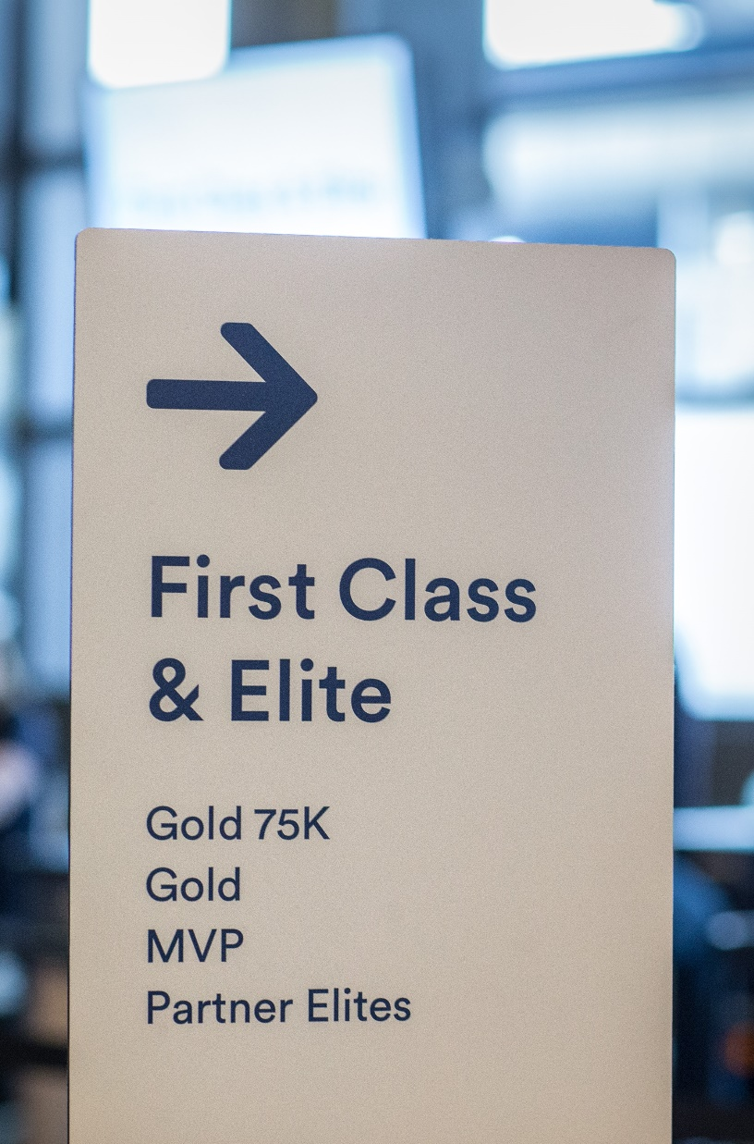

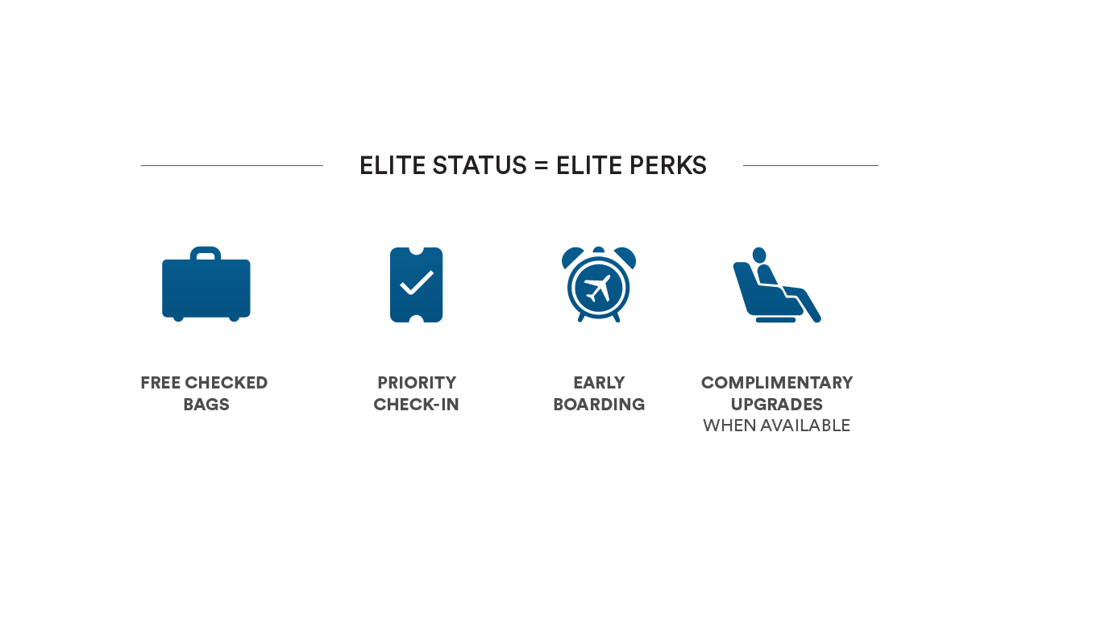
#MOSTWESTCOAST
The perks you deserve
for your loyalty
Alaska operates the most nonstop flights, to the most destinations, from the West Coast.
Over 1200 daily flights to 119 destinations in the United States, Canada, Mexico, Costa Rica and Cuba.
Elite Status = 20,000 Miles
Earn Elite status with just 4 round trips between HNL and SEA.
No minimum spend requirements.
Notes:
It’s easy to earn elite status on Alaska Airlines. Just four trans-con round trips earns MVP status, which comes with perks like better seats, early boarding and free checked bags.
MVP Gold level would take 8 trans-con round trips and has the unique benefit of all change fees waived. This offers your company substantial savings when compared to OA programs and fees.

Slide 14
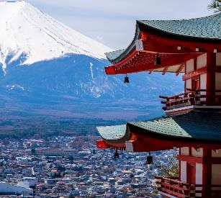
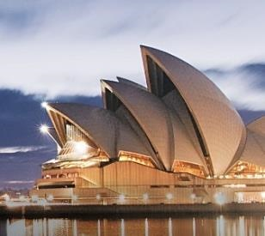

Earn towards elite status on Alaska global partners
Nonstop to Tokyo
Nonstop to Sydney
Nonstop to Seoul

Slide 15

ALASKA’S FAMOUS COMPANION FARETM OFFER – BRING A FRIEND FOR ONLY $99 (PLUS TAXES & FEES FROM $22)

Slide 16
More
to love.

Slide 17

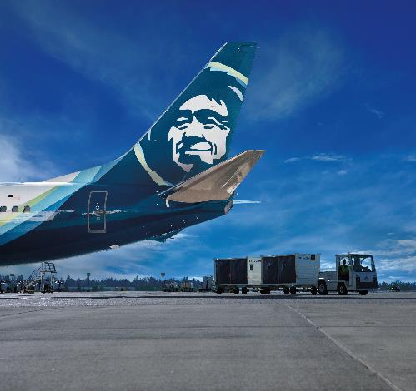



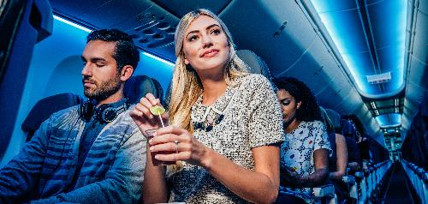
Warm & welcoming with a modern, West Coast-inspired vibe
HOSPITALITY
PERSONALITY
Ease
Comfort
Generosity
Enjoyment
Personalization
Thoughtful
Vibrant
Unconventional

Slide 18
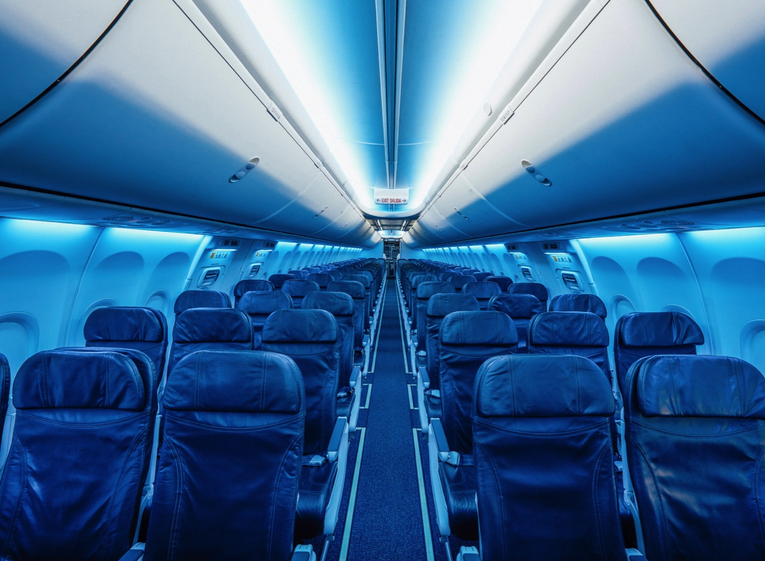
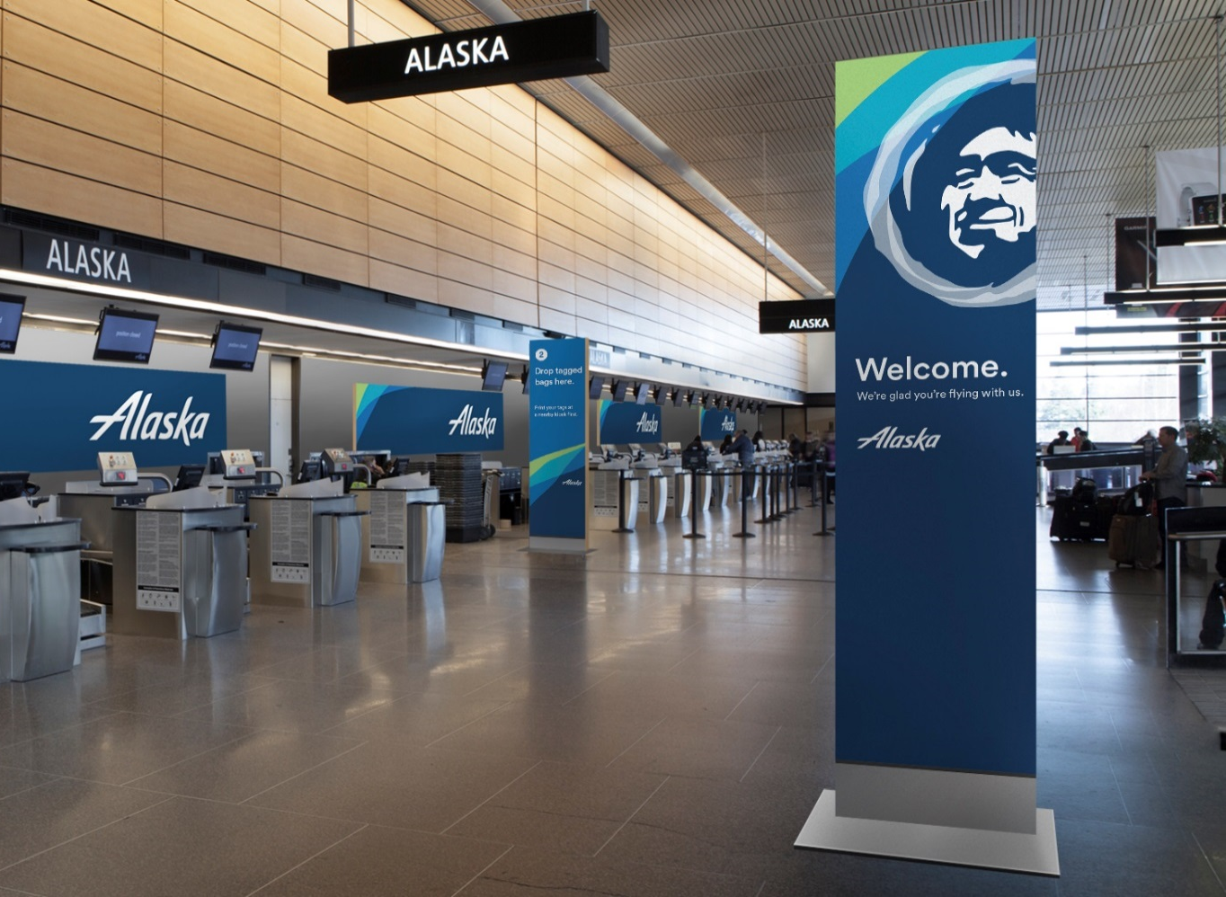



Lighting and music will play a prominent role across the fleet and at the airport
Blue Mood Lighting
Music in Lobbies, Gates, Onboard

Slide 19
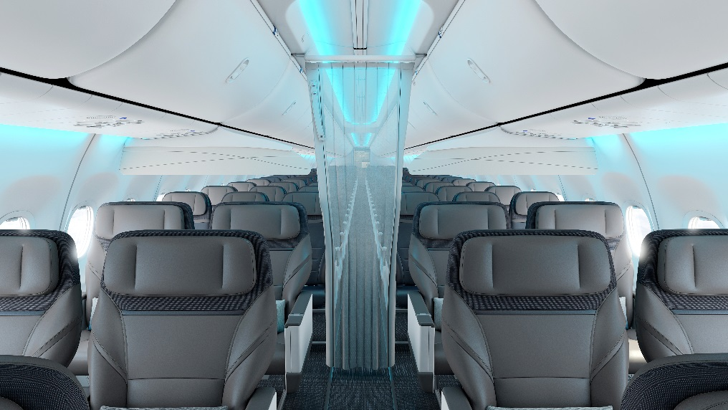
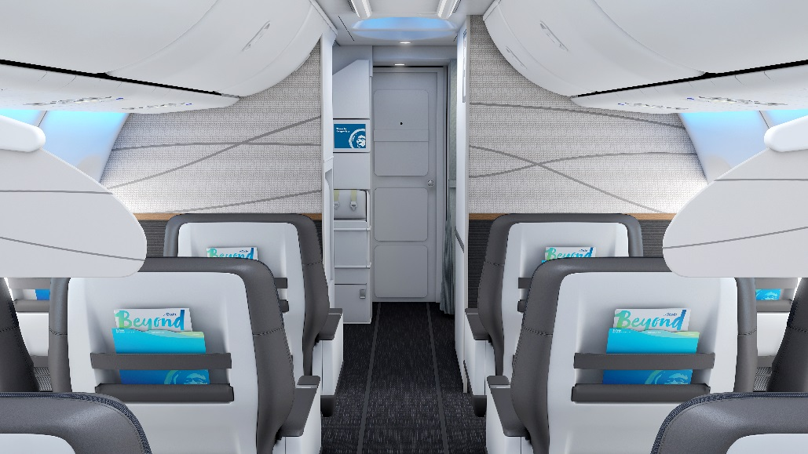
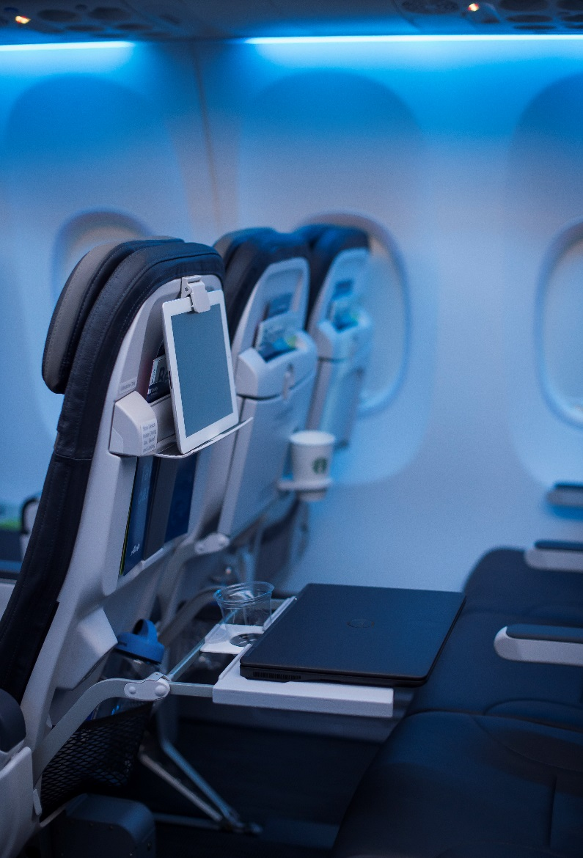
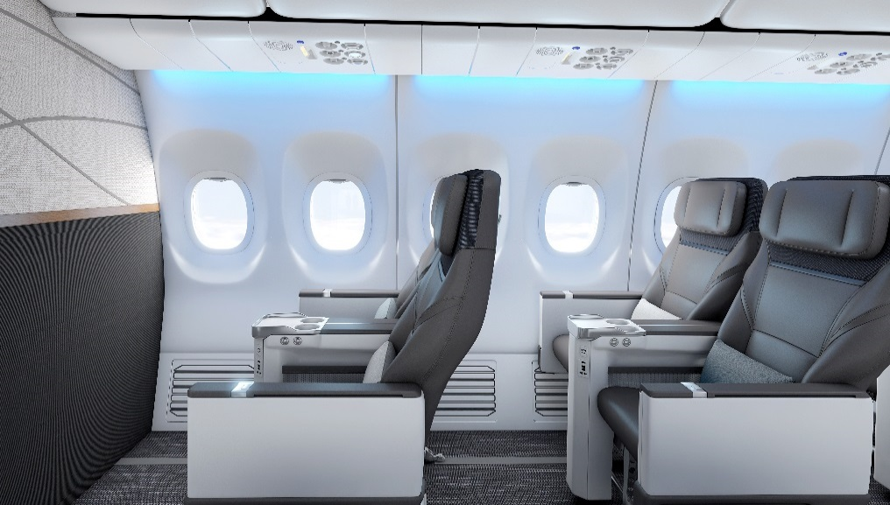
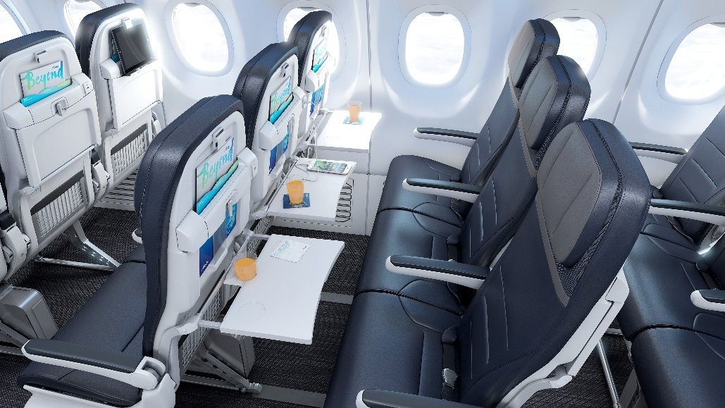
A comforting new look and feel for the cabin

Slide 20

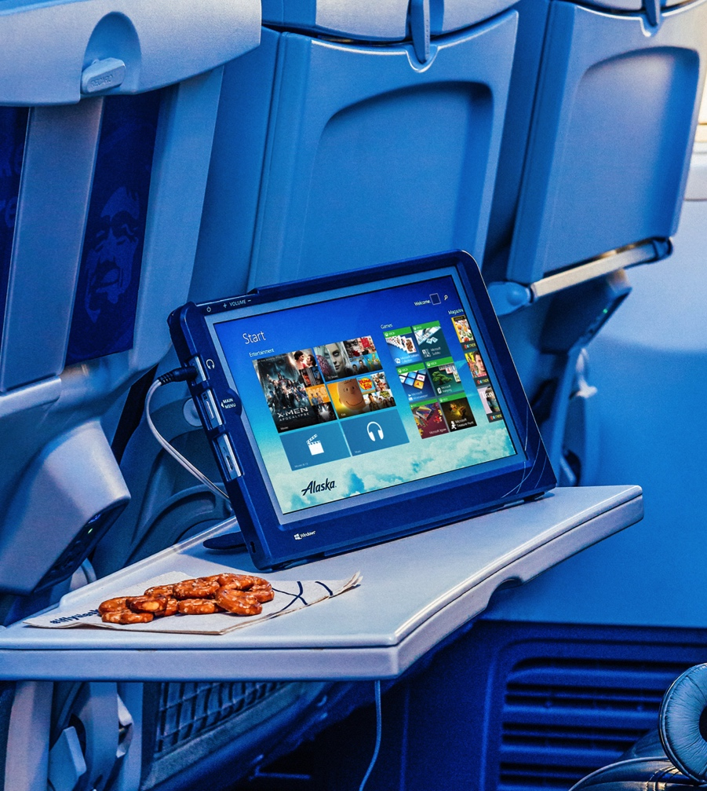
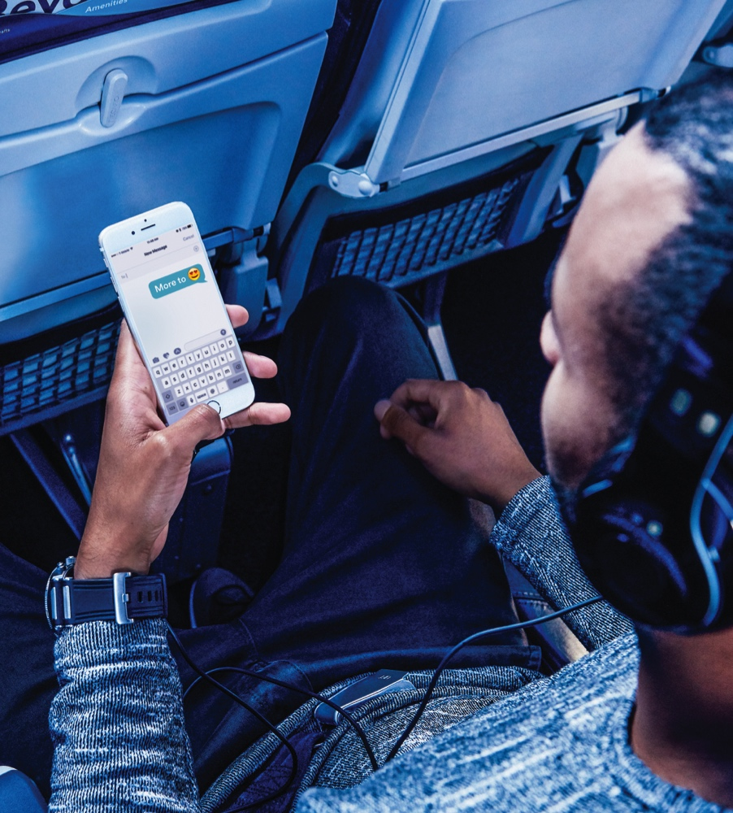
The brand will focus on connectivity and entertainment
Satellite Connectivity
Free Movies
Free Chat

Slide 21
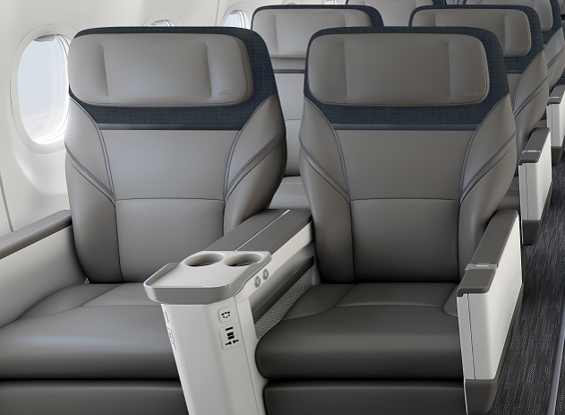
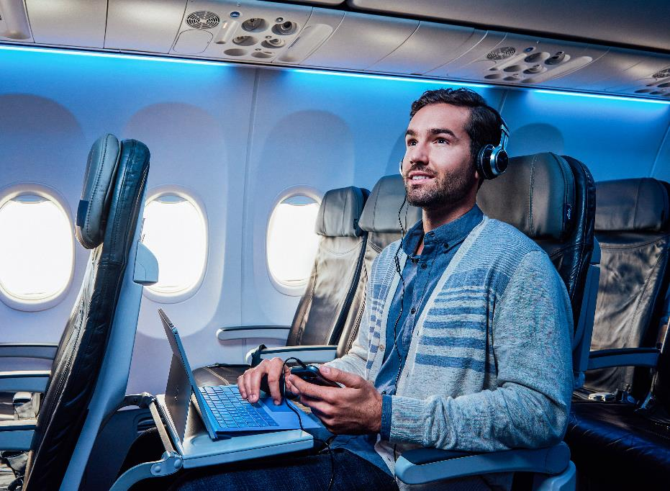
Offering premium seating with generous upgrades
New 41” Pitch First Class Seats
35” Premium Class Seats

Slide 22
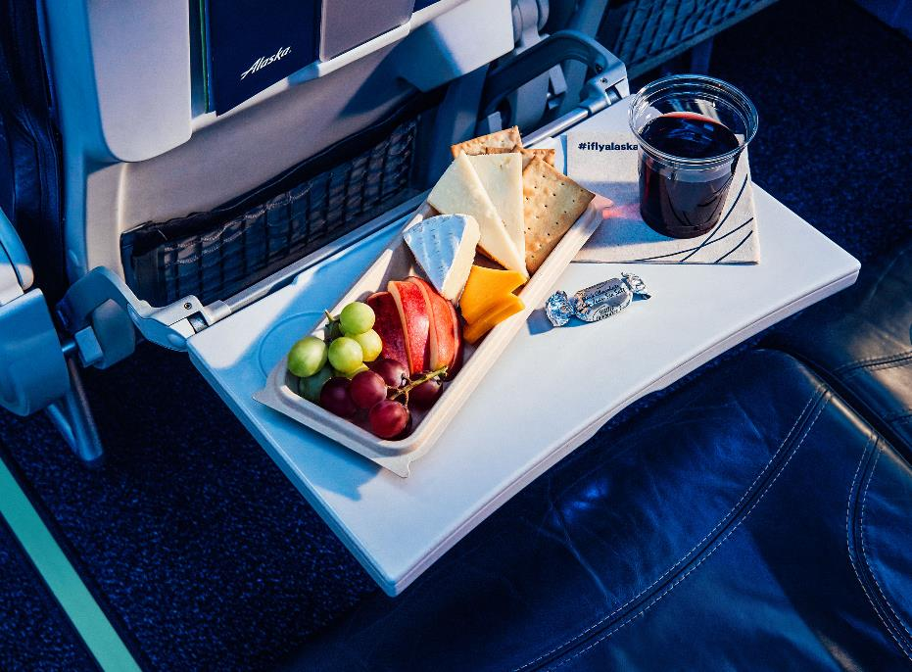
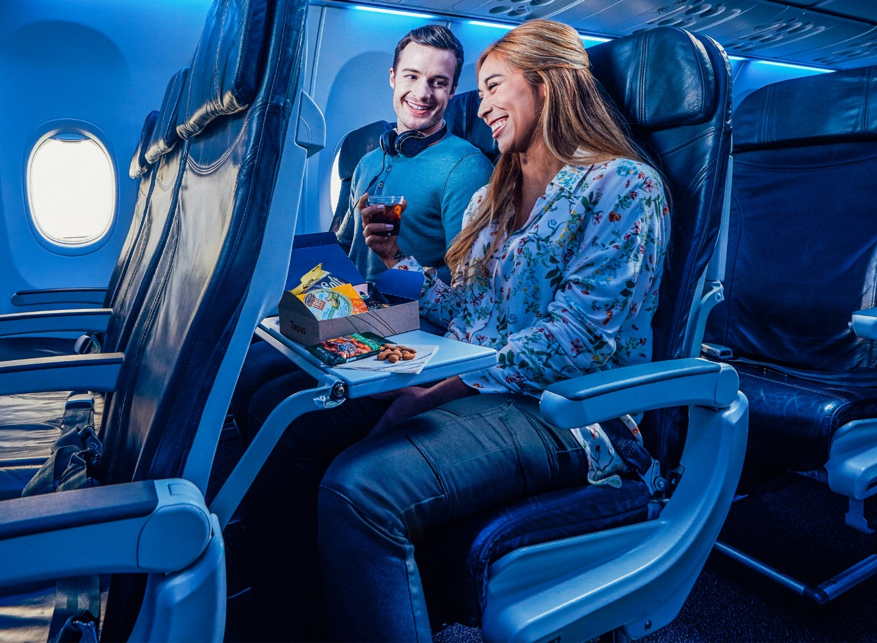
Fresh, healthy West Coast food offerings with the ability to order and pay pre-flight
Premium Food & Beverage
Pre-Order & Pre-Pay

Slide 23






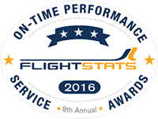


Taking care of our customers with our shared
passion for service
Highest in Customer Satisfaction among Traditional Carriers in North America, Ten Years in a Row.
Best Domestic Airline in Travel + Leisure World’s Best Awards for 2008-2017. Ten years in a row.
Ranked #1 Airline by Wall Street Journal four years in a row.
Best U.S. Airline in Condé Nast Traveler 2008-2016 Readers’ Choice Awards. Nine years in a row.
U.S. News & World Report “Best Airline Travel Rewards.” Three years in a row.
Ranked #1 U.S. Airline by the Airline Quality Rating. Four years in a row.
Most On-Time North American Major Airline. Seven years in a row.
Ranked #1 Domestic Airline in Travel + Leisure and Fortune Best in Business Travel Survey 2014-2015.
Alaska Air Group has received a perfect score on the 2017 Corporate Equality Index (CEI).
Fast Company’s Top 50 Most Innovative Companies, 2015 (#8).
Alaska Airlines received the highest numerical score in the J.D. Power 2008-2016 North America Airline Satisfaction Studies. 2016 study based on 10,348 total responses evaluating 4 traditional carriers, and measures the experiences and perceptions of passengers who were surveyed between April 2015 and March 2016. Your experiences may vary. Visit jdpower.com
Notes:
Separately, the two companies are strong. We each consistently win awards for customer service and performance, and are known for our low fares, innovative approaches and caring employees.
And we’ll continue taking care of your travelers since Alaska and Virgin America bring a shared passion for consistently delivering award-winning service.

Slide 24
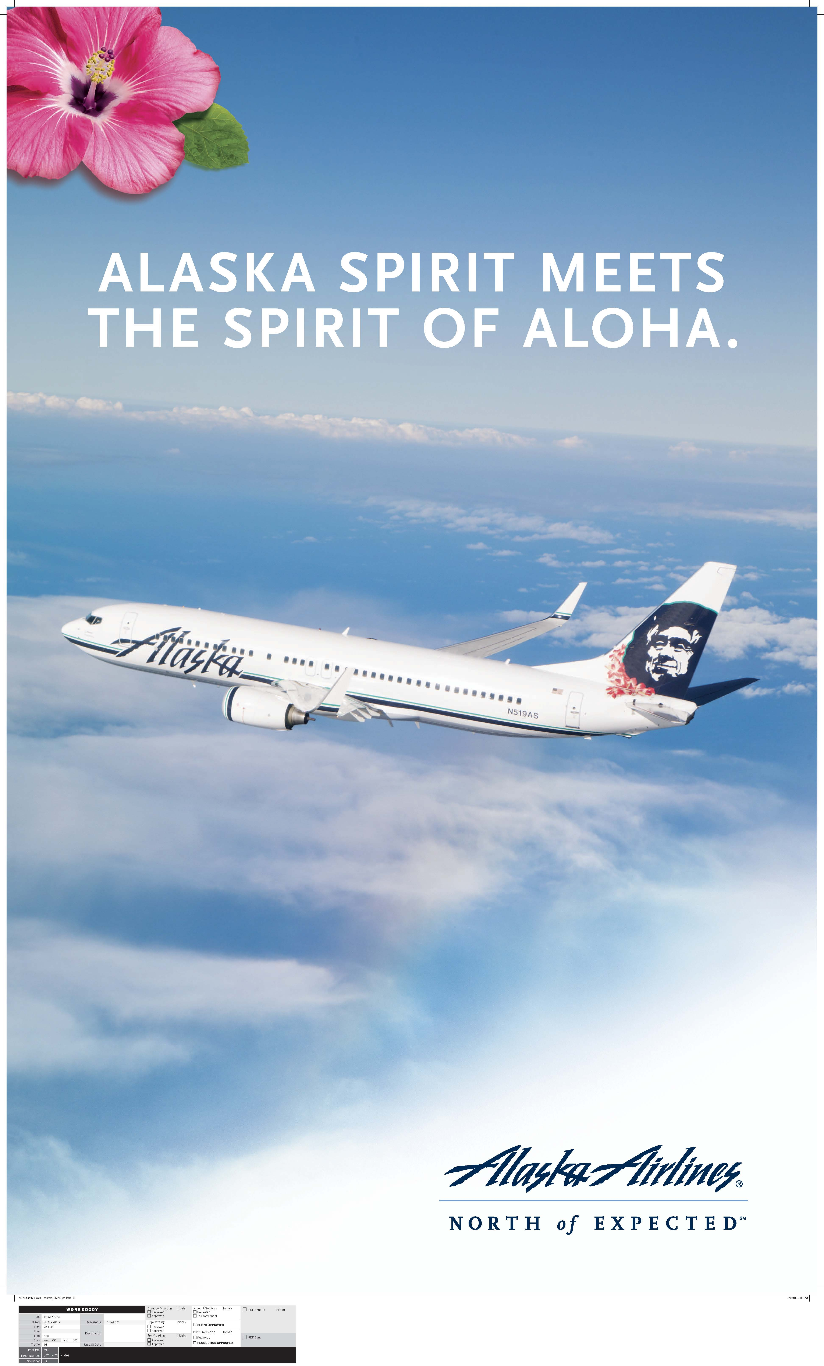
Celebrating 10 years in Hawaiʻi
  From October 2007, we have grown from 3 daily flights to 26 daily flights from 4 islands.
  Today, we carry over 25% of all passengers flying to Hawai‘i from the West Coast.
  Our growth has helped overall capacity in Hawai‘i-U.S. Mainland to surpass its 2006 peak in 2015.
  Our biggest strength and area of focus is the West Coast to/from the Neighbor Islands, which helps to distribute tourism’s economic impact across the entire state.

Slide 25
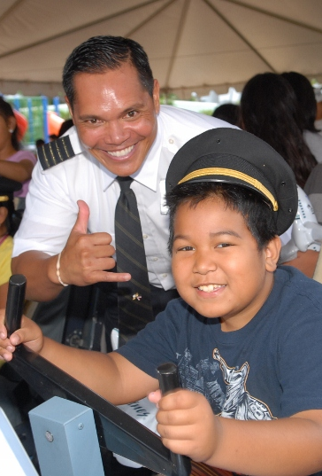
We’re committed to our island communities
$2.5 million donated to Hawaiʻi charities.
140+ local non-profits served.
30+ company-sponsored community events.
$120K in Alaska Airlines Foundation grants.
Notes:
It’s a mileage based loyalty program with means your travelers earn miles for miles flown and not dollars spent.
And we are ranked #1 for the most reward travel availability which means your travelers will have an easy time redeeming miles for award travel.
Source: Switchfly Reward Seat Availability Survey, Seat availability June-October 2015
Overall Reward Availability Ranked High to Low – Seat Availability June through October, 2015
http://www.ideaworkscompany.com/wp-content/uploads/2015/05/Press-Release-97-Reward-Seat-Report-2015.pdf

Slide 26
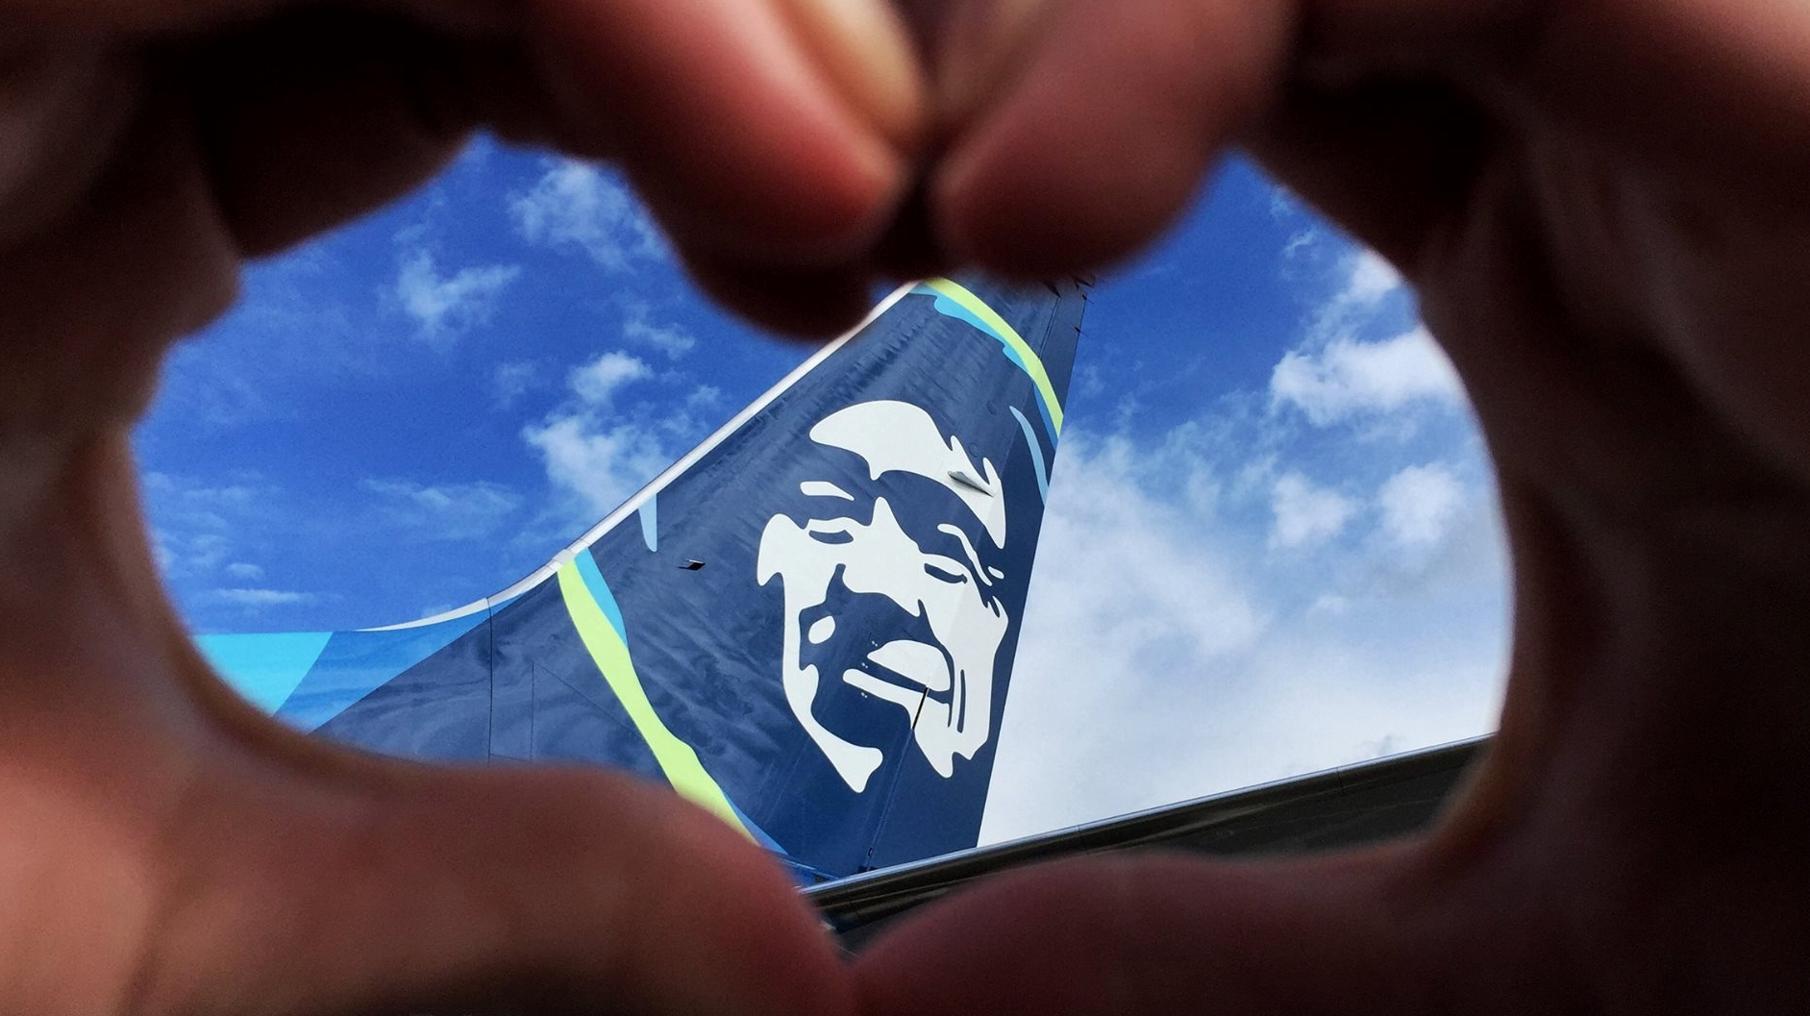

Our values
Own
safety
Do the
right thing
Be
kind hearted
Deliver
performance
Be
remarkable
Notes:
Values and focus areas are important, but not going to talk a lot about them – want to let you judge how we do

Slide 27
Be
kind-hearted.
We care deeply.
By showing genuine kindness to our guests and one another, we continually earn our reputation of being an airline people love.
Notes:
We care deeply. By showing genuine kindness to our guests and one another, we continually earn our reputation of being an airline people love.

Slide 28
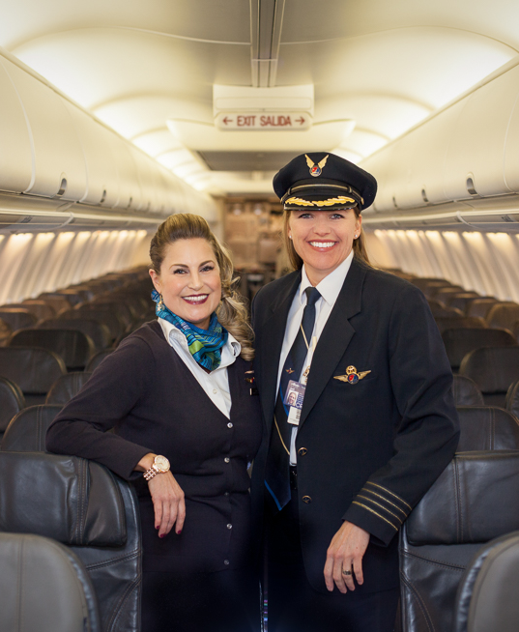
Jenny Stansel
Flight Attendant
Jodi Harskamp
Pilot Captain

Slide 30
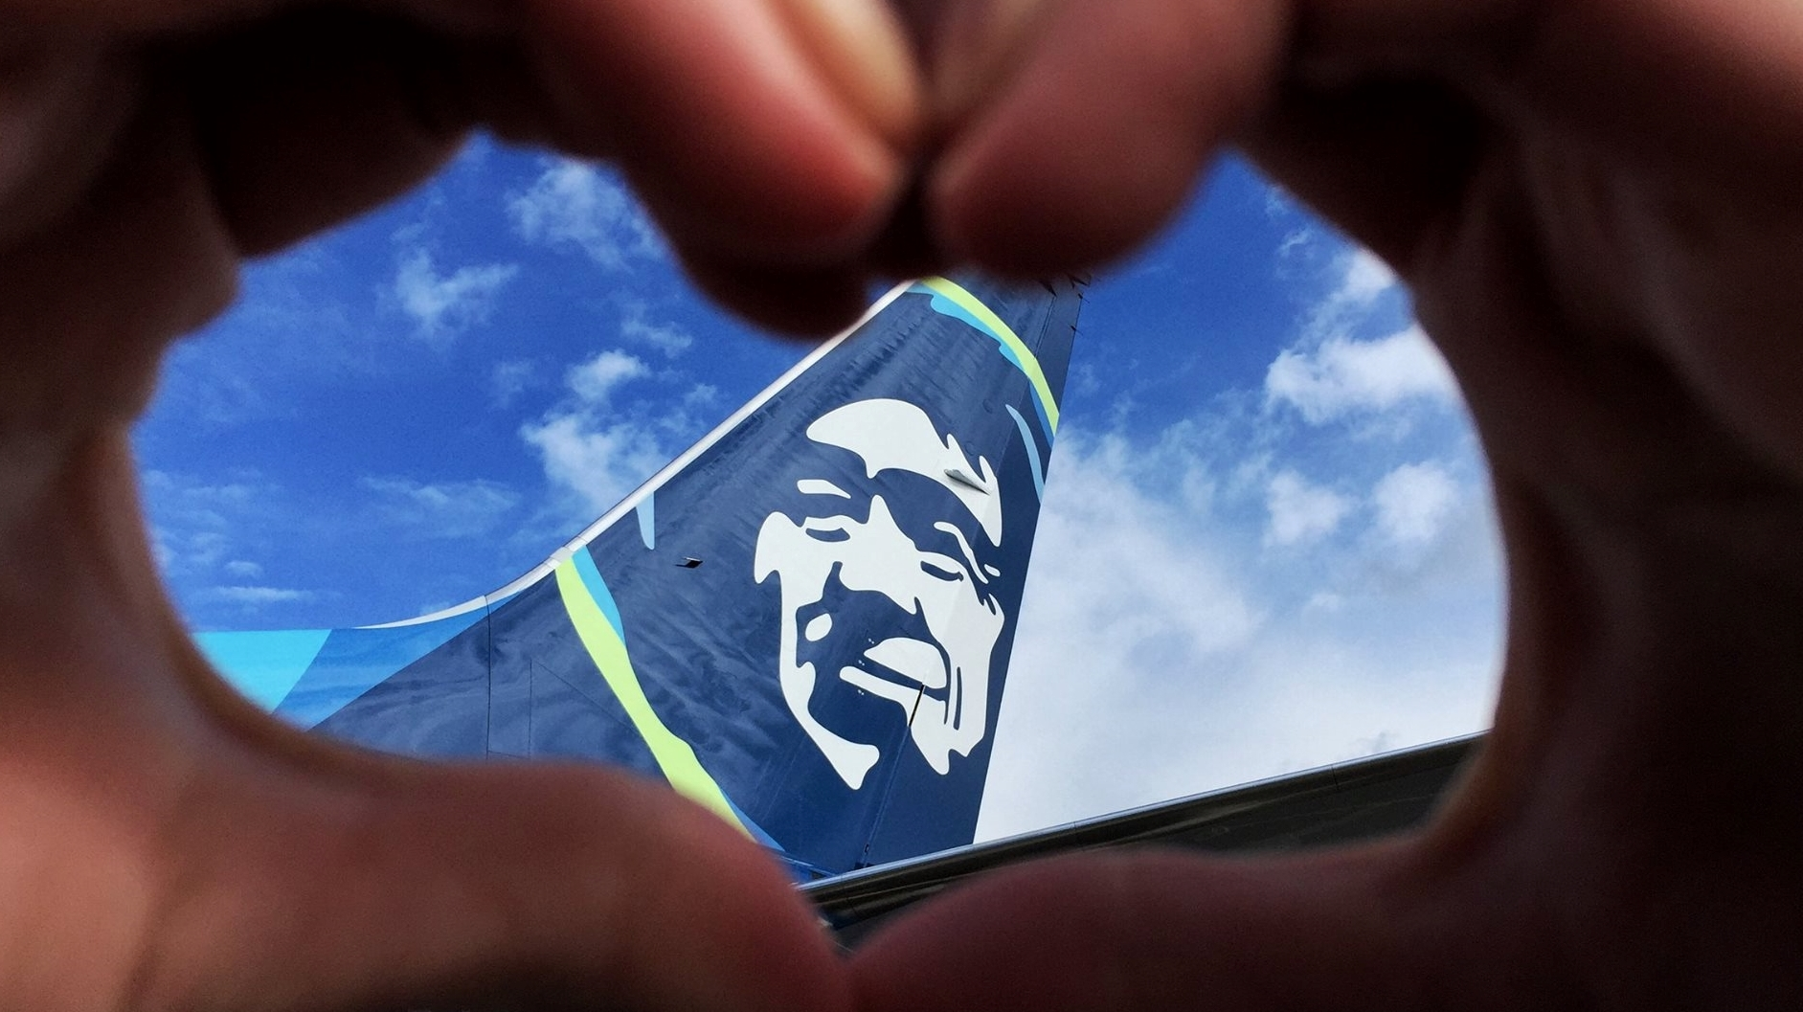
Creating an airline people
love.
Notes:
Talked about aligned employees – aligned around culture
Love, not like
ING – creating, always working on

