Slide 1
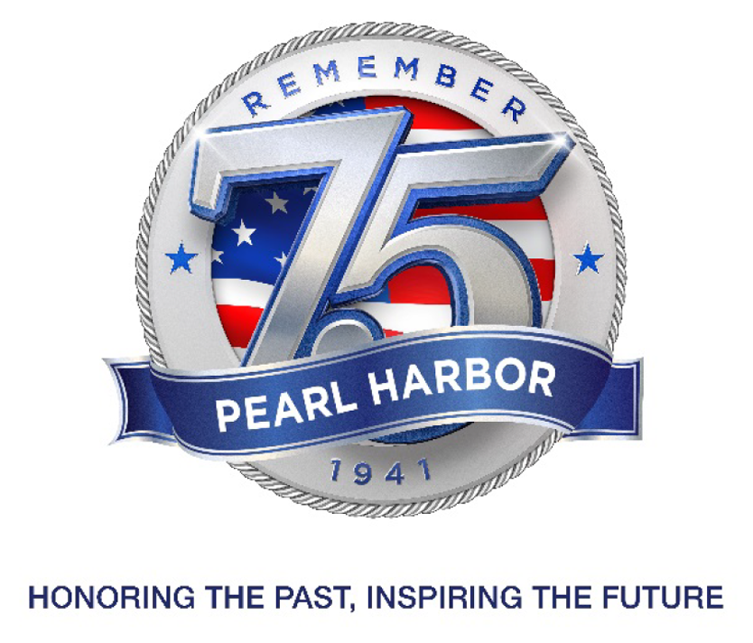

Slide 2
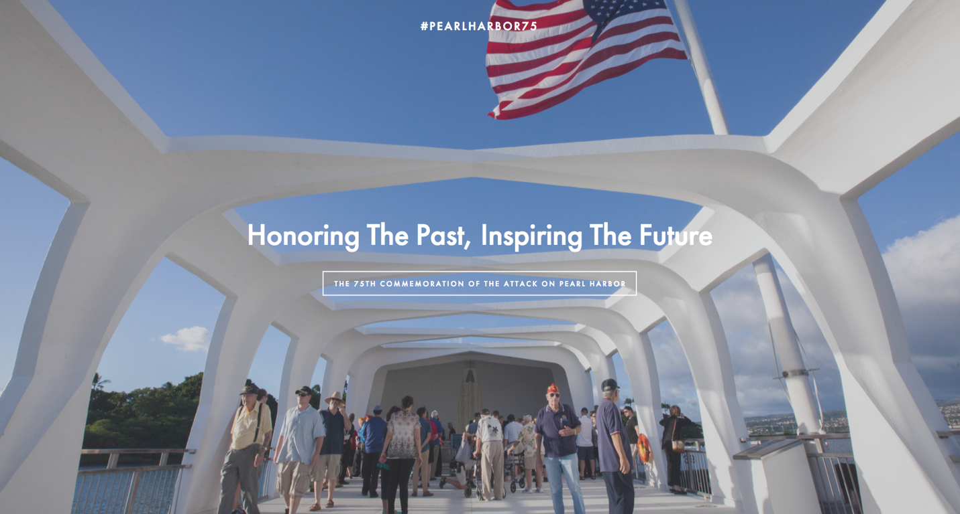

Slide 3
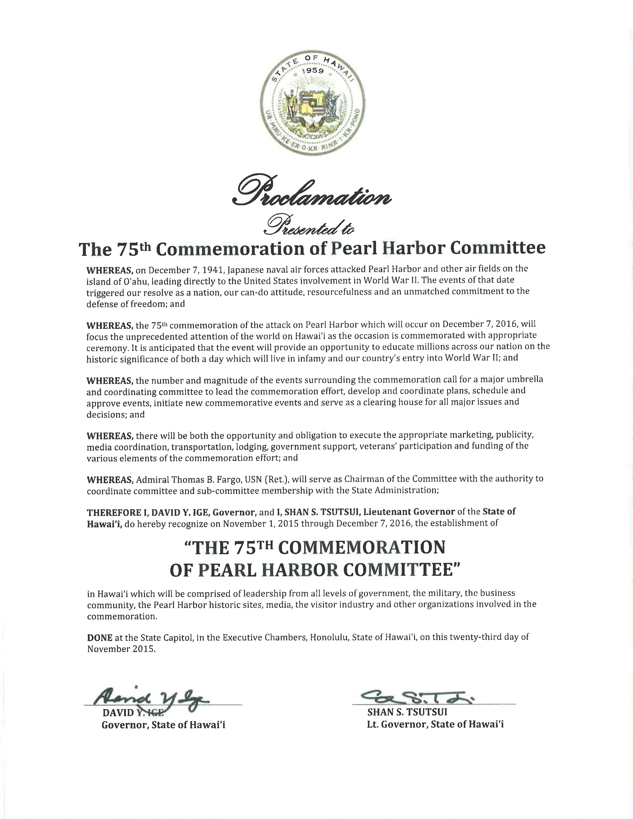
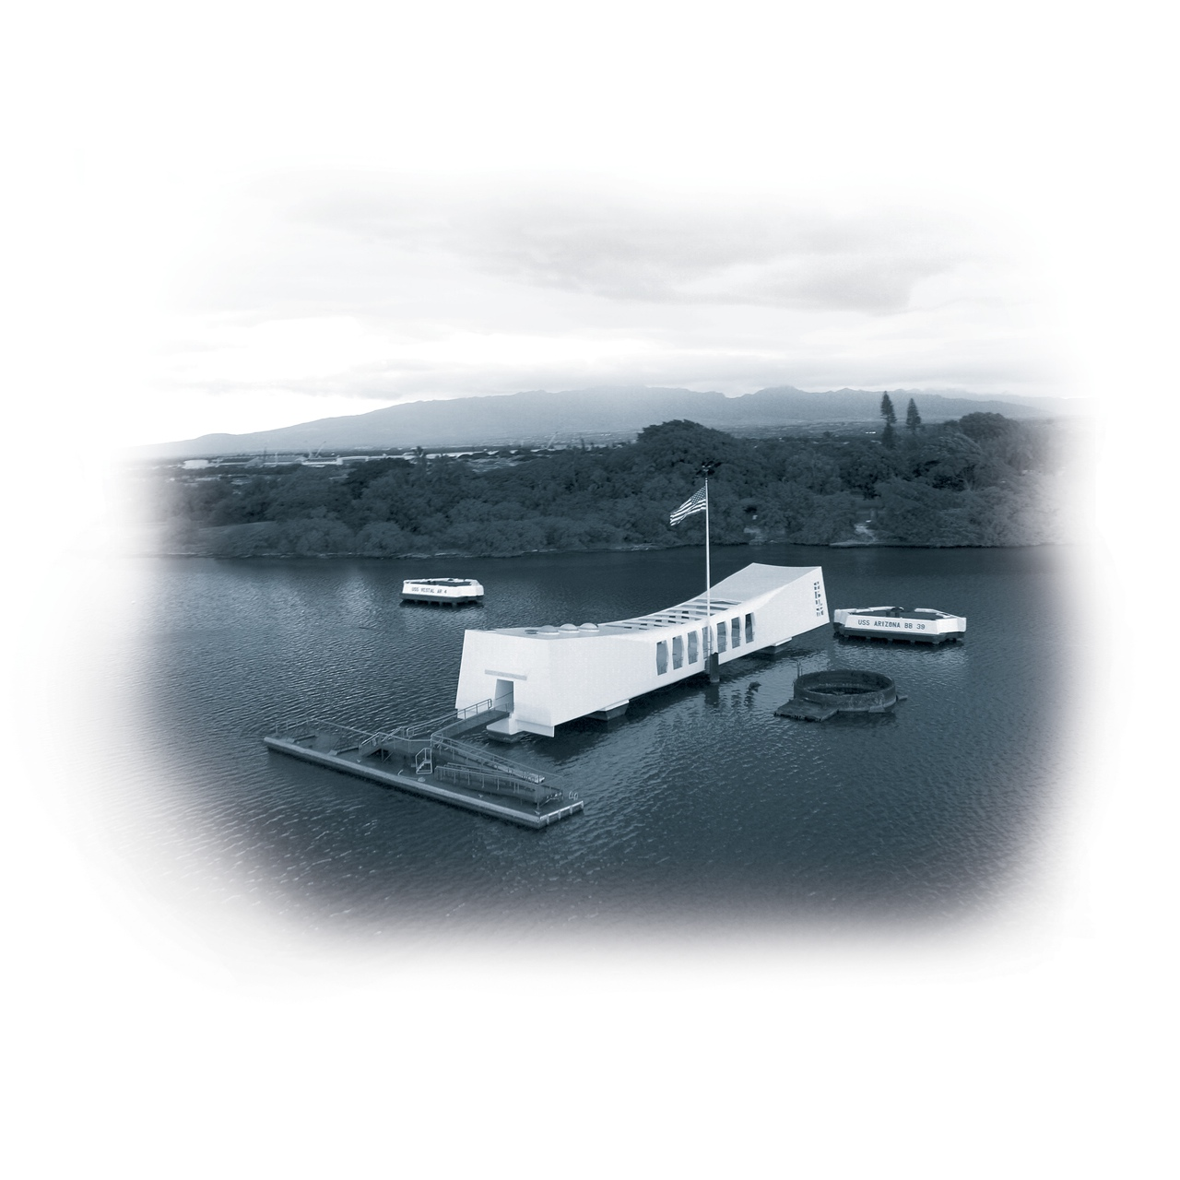
Proclamation
by
Hawai‘i’s Governor David Y. Ige

Slide 4
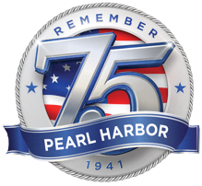
75th COMMEMORATION
OF THE ATTACK ON PEARL HARBOR
Honoring the Past, Inspiring the Future
HONORARY CO-CHAIRMEN
Governor David Y. Ige
ADM Harry B. Harris, Jr., USN
HONORARY MEMBERS
The Honorable Brian Schatz
The Honorable Mazie K. Hirono
The Honorable Tulsi Gabbard
The Honorable Mark Takai
COMMEMORATION COMMITTEE
Chair
ADM. Thomas B. Fargo, USN (Ret.)
Vice Chair
CAPT Steven W. Colón, USN (Ret.)
LIAISON MEMBERS
LTG Anthony Crutchfield, USA
RDML John V. Fuller, USN
Jacqueline Ashwell
Hawai‘i State Senator Clarence Nishihara
Hawai‘i State Representative Ken Ito
Roy Amemiya
Rick Blangiardi
David Carey
Clint Churchill
Chuck Cotton
Ron Cox
Mark Dunkerley
Dennis Francis
Jerry Gibson
Tim Guard
Mufi Hannemann
Jim Horton
Thomas Lee
MGEN Joe Logan, USA
Sherry Menor-McNamara
John Monahan
Jennifer Sabas
Kelly Sanders
Neil Sheehan
George Szigeti
Donna Tanoue
Chris Tatum
ADM R. J. Zlatoper, USN (Ret.)
c/o Pacific Historic Parks • 94-1187 Ka Uka Boulevard • Waipahu, Hawai’i 96767

Slide 5
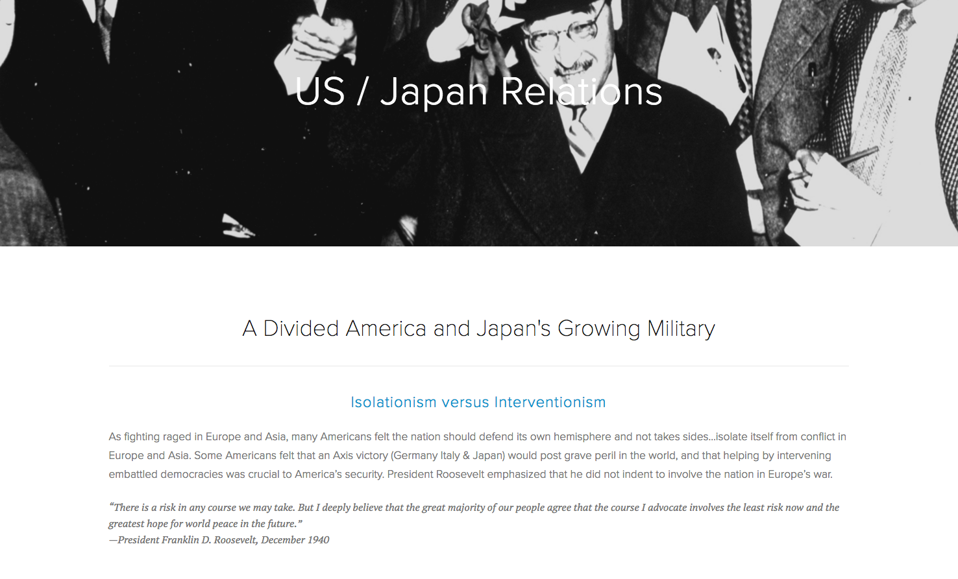
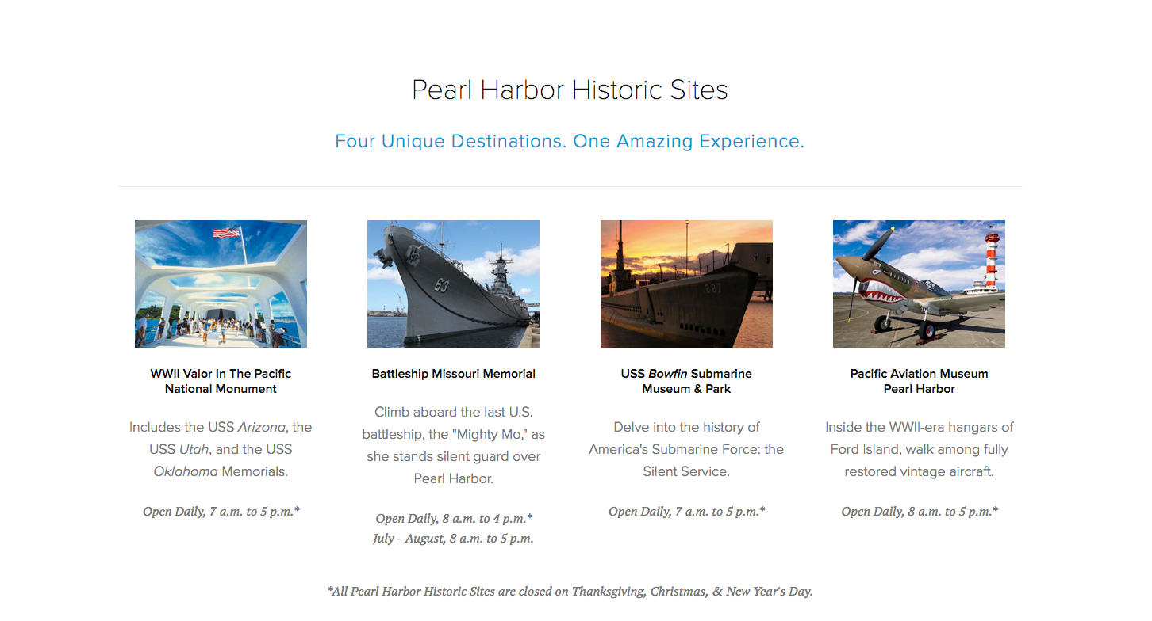
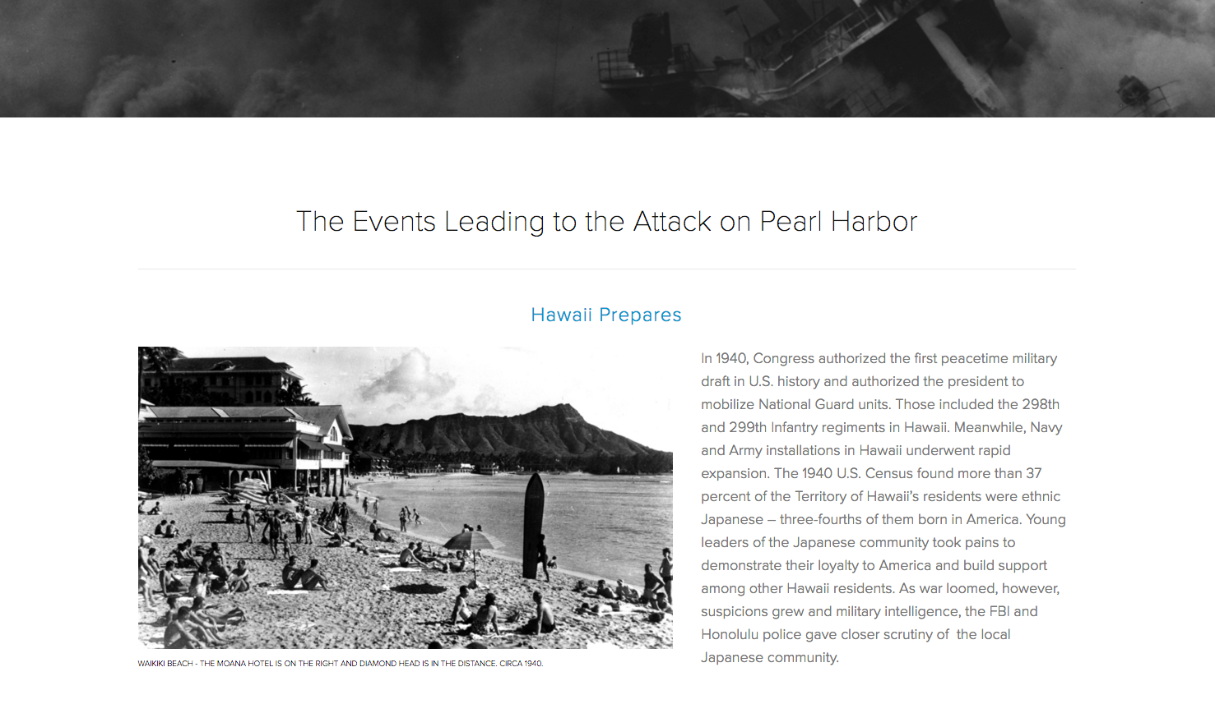
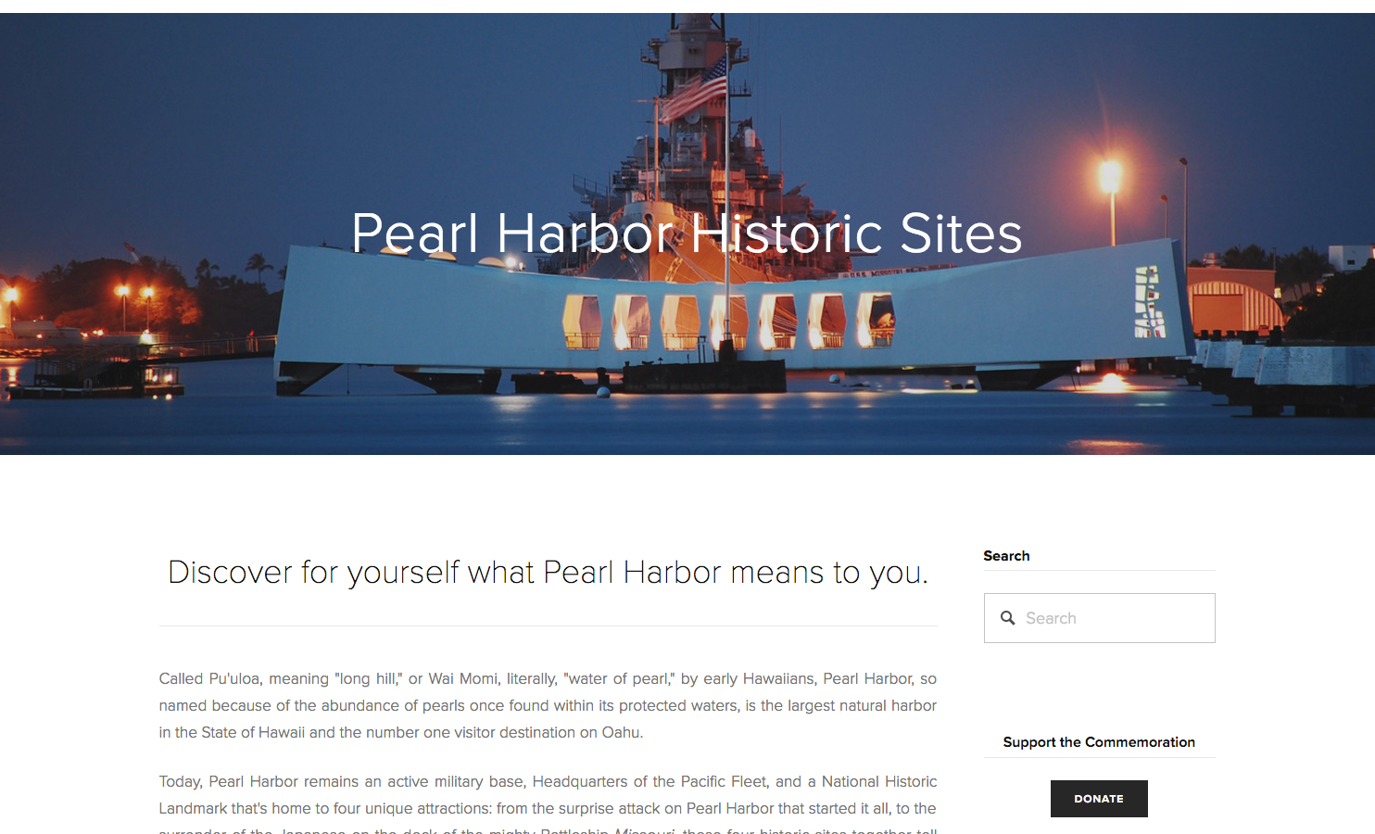
On the Website
Historic Sites
History

Slide 6
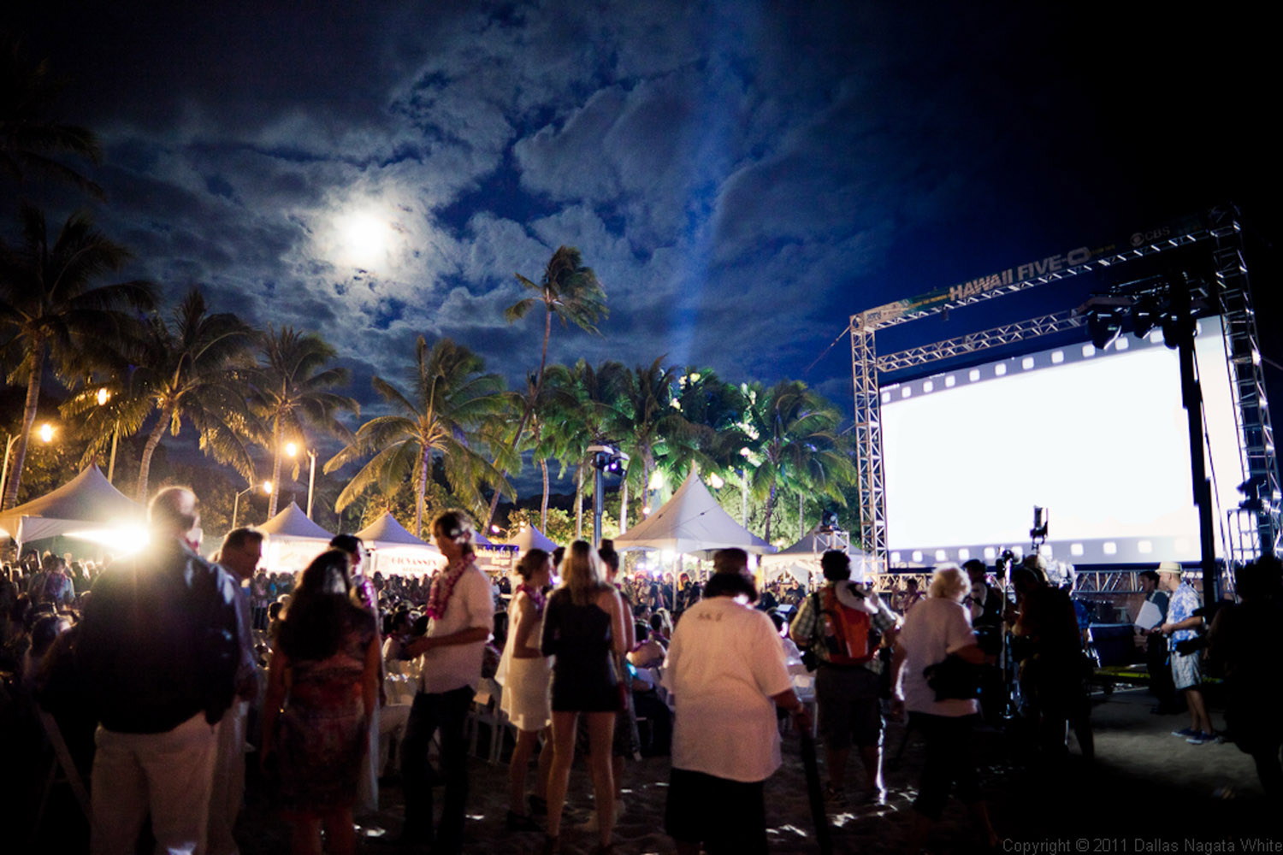
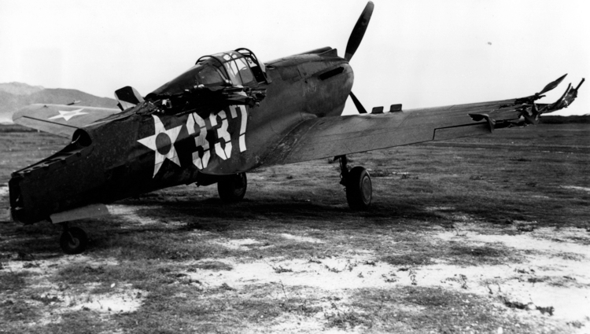
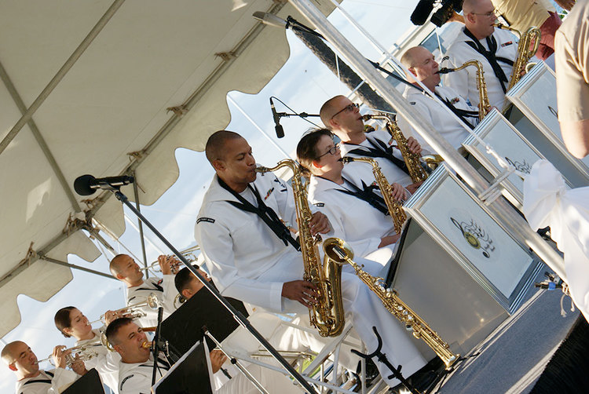
Schedule Highlights
DEC 2 - 9
SUNDAY • DEC 4
(5) Movie Nights on the Beach
“Remember Pearl Harbor” Documentary Film Premiere
MONDAY • DEC 5
SATURDAY • DEC 3
AJA Veterans Luncheon
“For Love of Country” Opening Night Gala
TUESDAY • DEC 6
Pearl Harbor Survivors
Gala Tribute

Slide 7
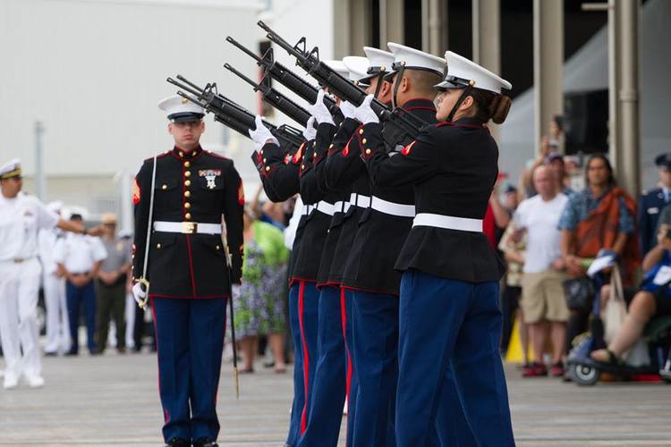
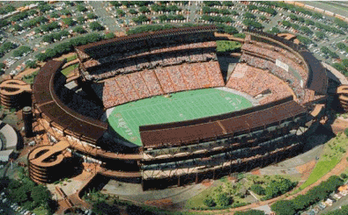
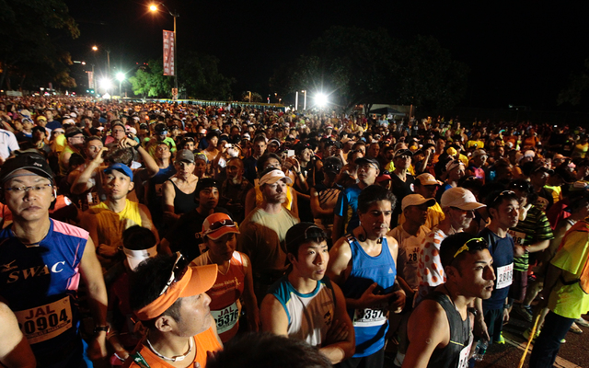
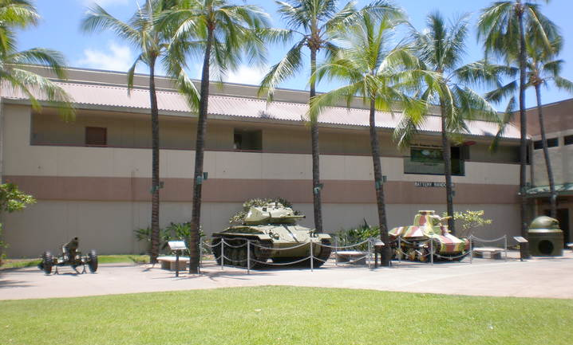
Schedule Highlights
WEDNESDAY • DEC 7
SATURDAY • DEC 10
National Pearl Harbor Remembrance Day Commemoration
World-Class Concert at
Aloha Stadium
SUNDAY • DEC 11
THURSDAY • DEC 8
Honolulu Marathon
(Honoring the Past, Inspiring the Future)
Celebration for Veterans, Active Duty Personnel and their Families

Slide 8
Conclusion
Website
PearlHarbor75thAnniversary.com
Contact
Elissa Lines: (808) 445-9069
elissa.lines@pacificaviationmuseum.org
Ray L’Heureux: (808) 225-2235
rlheureux@pacifichistoricparks.org
Tony Vericella: (808) 295-0200
tonyv@islandpartnershawaii.com

